Slide 1
AA284B Team A
Critical Design Review
March 11, 2020
Efaine Chang Rishav Choudhary Bernadette Haig
Walker Kehoe Tom McClure Jeff Robinson
Elida Sorto-Ramos Alec Taraborrelli Wouter Van Gijseghem

Slide 2
Agenda
Project Goals
Updated System Parameters
Changes Since PDR
Safety Factors
Budget & Fabrication
Revised Plans and Schedule
Engineering Drawings

Slide 3
Goal
Startup, shutdown, and restart of LOx-GCH₄ engine
Stretch Goals:
Stable combustion (P_{c} oscillation <5% mean)
Measure C* efficiency
Image engine startup and reignition

Slide 4
System Parameters
Oxidizer | Liquid Oxygen
Fuel | Gaseous Methane
Chamber Pressure | 10 bar (~150 psia)
Thrust | 640 N (~144 lbf)
Throat Diameter | 25.4 mm (1 in)
O/F Ratio | 2.5
Ox Mass Flow Rate | 0.1986 kg/s
Fuel Mass Flow Rate | 0.0795 kg/s
Ox Pressurization | Compressed Helium
Nozzle Expansion Ratio | 2.18 (Sea Level Optimal)
Injector | Shear Coaxial: LOx center, Methane annular
Igniter | Gas-Gas Impinging with spark plug ignition
I_{sp} | 230 sec

Slide 5
Changes Since PDR

Slide 6
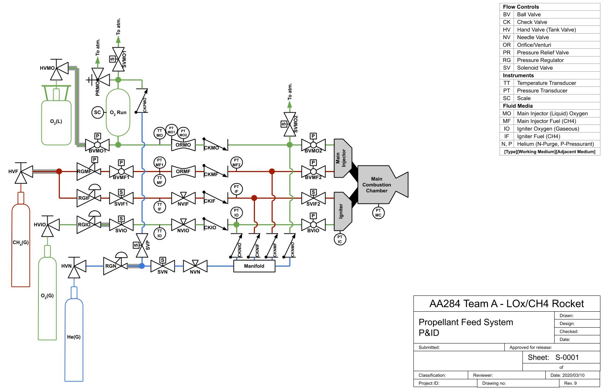
P&ID
Relief Added
Helium - Addresses LOx solubility concerns, and is not too expensive ($310 He vs $54 N₂)

Slide 7
P&ID Fitting Accounting Spreadsheet
https://docs.google.com/spreadsheets/d/1Akb-G0P3gi-R2JIjckR0jrPFSVN0DPMDoXRMupv_SYY/edit?usp=sharing

Slide 8
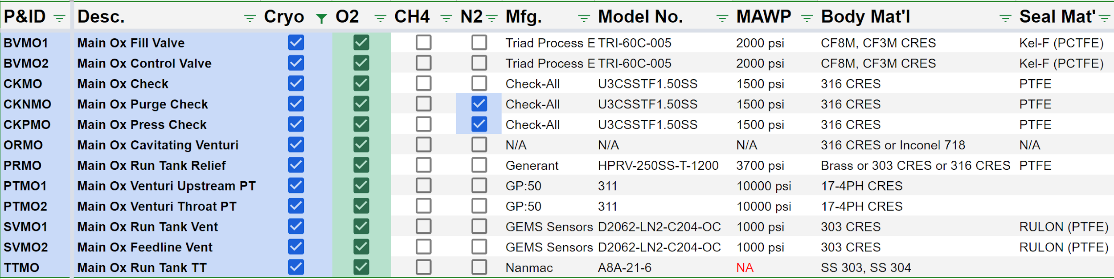
P&ID Fitting Accounting: LOX

Slide 9
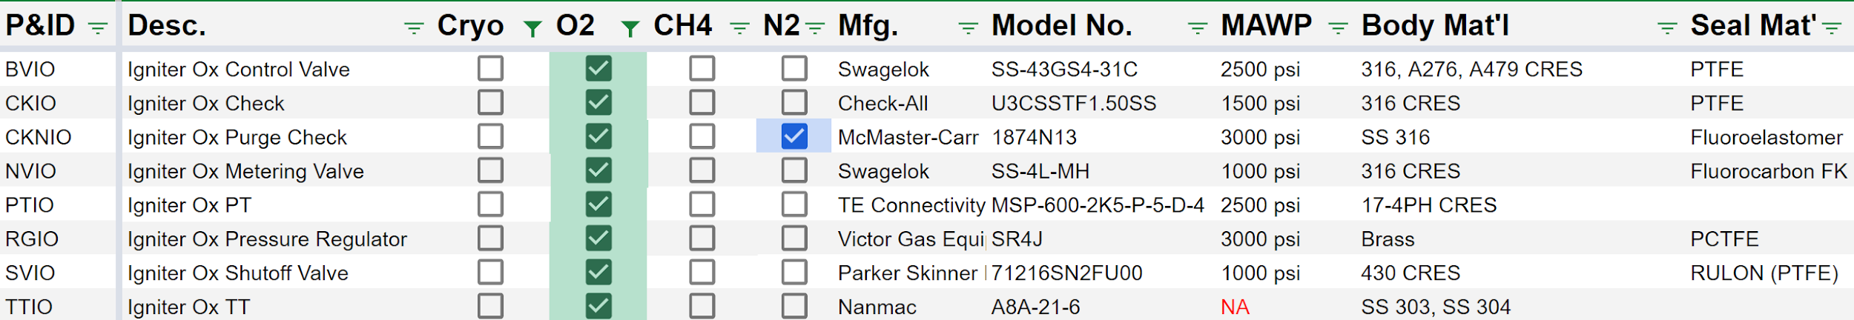
P&ID Fitting Accounting: GOX

Slide 10
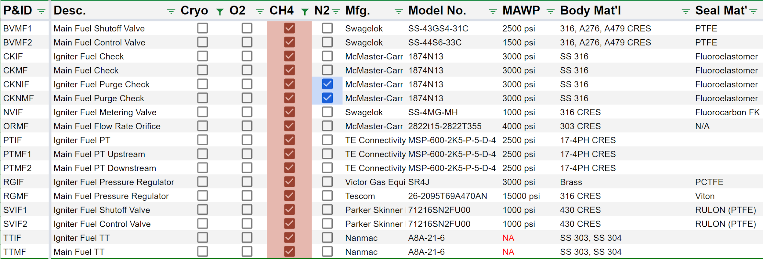
P&ID Fitting Accounting: GCH4

Slide 11
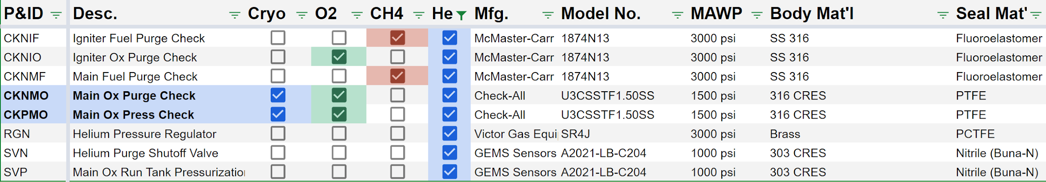
P&ID Fitting Accounting: He

Slide 12
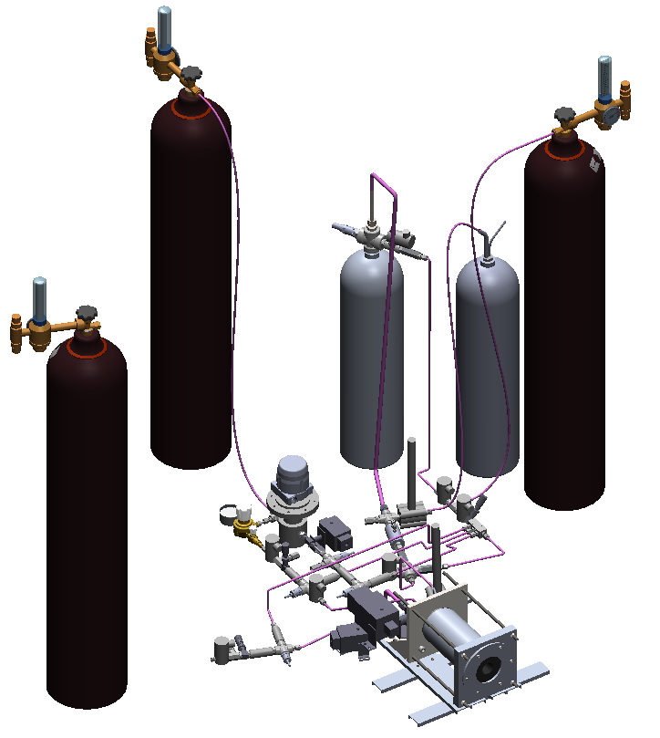
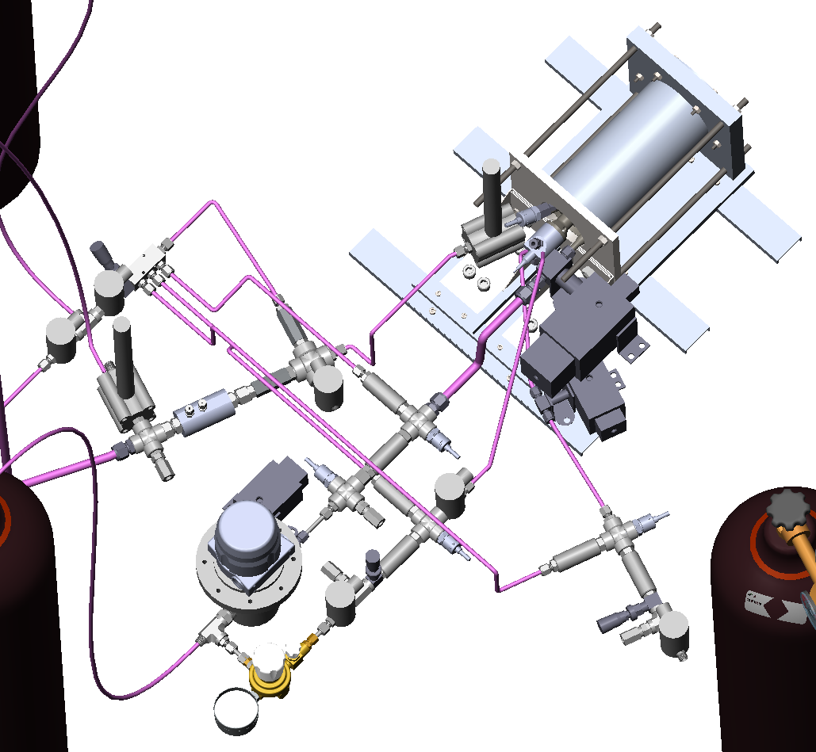
Overall System Layout (image)

Slide 13
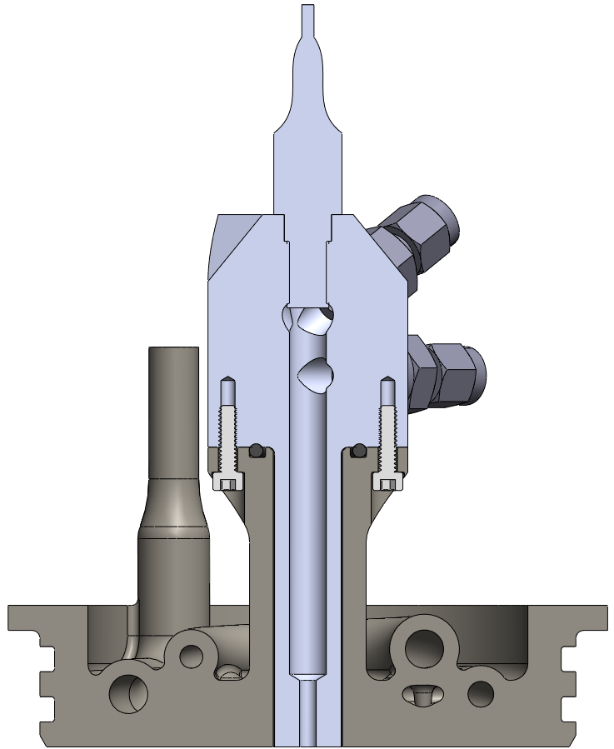
Injector/Igniter Assembly
Replaced threaded connection with bolt circle
Allows control over igniter clocking relative to injector
Prevents fitting interference between igniter & main propellant lines
Moved interface farther from injector face
Easier access to machine O-ring gland and bolt holes
Igniter is now “sleeve” inside injector, easier to replace than threaded
Can split igniter into “fitting head” and chamber if needed for machinability or material compatibility
FoS >11 Yield
Hand Calculation: Thread shear area = thread minor dia.
0.88” O-Ring gland OD
150 psi
316 CRES, F_{TY} = 25 ksi
-115 O-Ring
4X 6-32 Screws

Slide 14
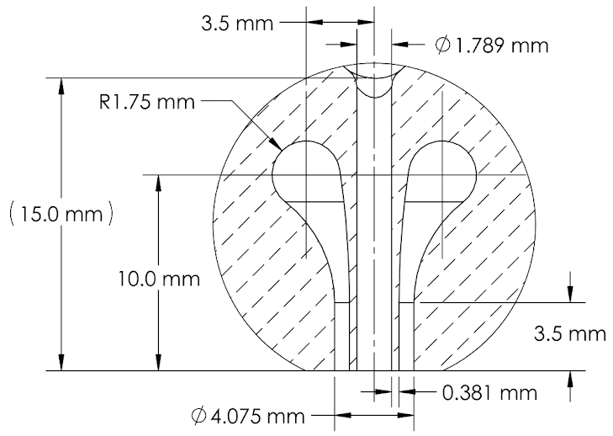
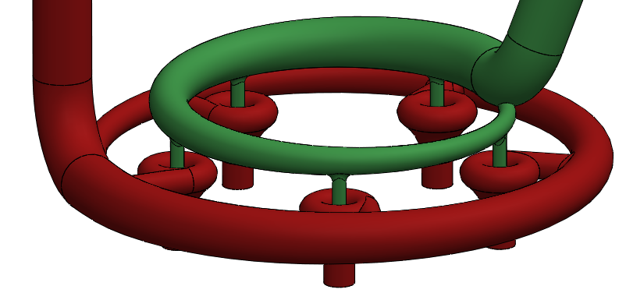
Main Injector
Annular gap increased to 0.03” for printability
10 → 5 Elements to maintain high momentum flux ratio
Swirl → Shear Coaxial for printability & simplicity
To Do: CFD to determine actual discharge coefficients

Slide 15
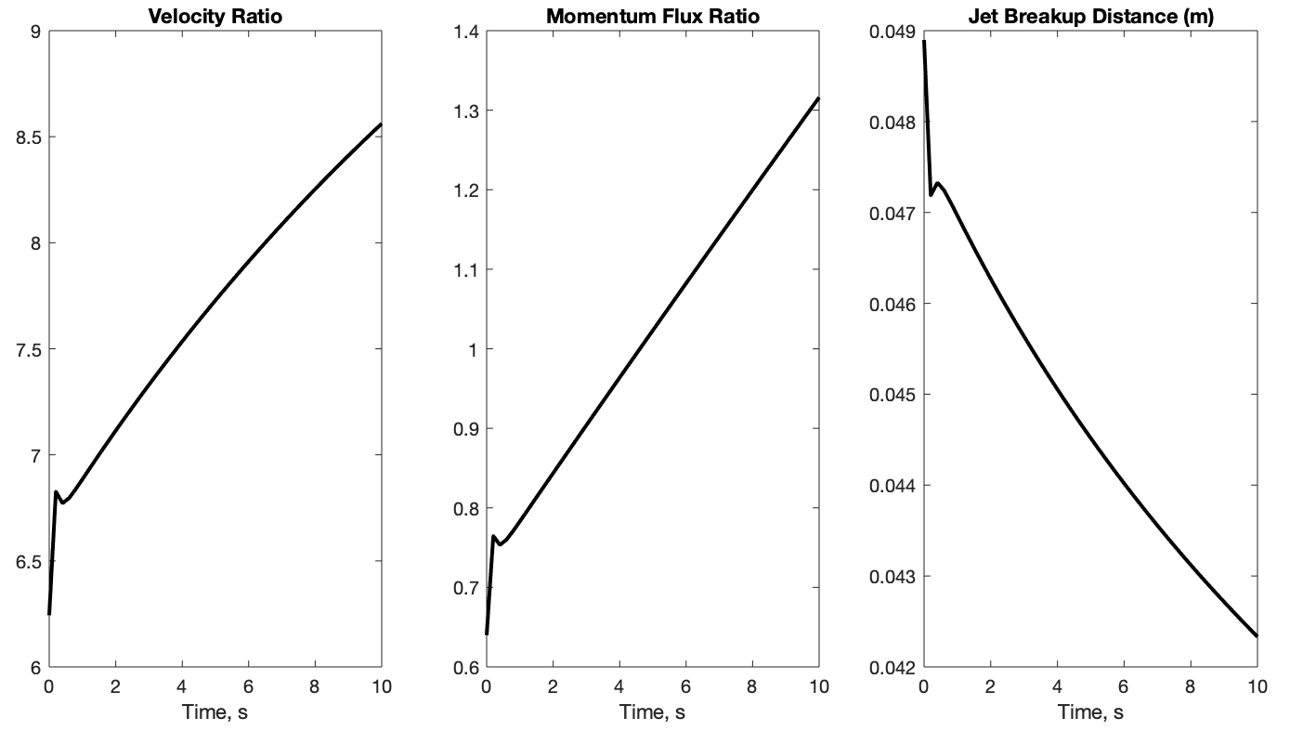
Main Injector Element Characteristics
Breakup distance correlation from this paper: https://doi.org/10.2514/1.26538
Chamber Length ~0.16 m
Good performance expected, but injector behavior still needs to be characterized

Slide 16
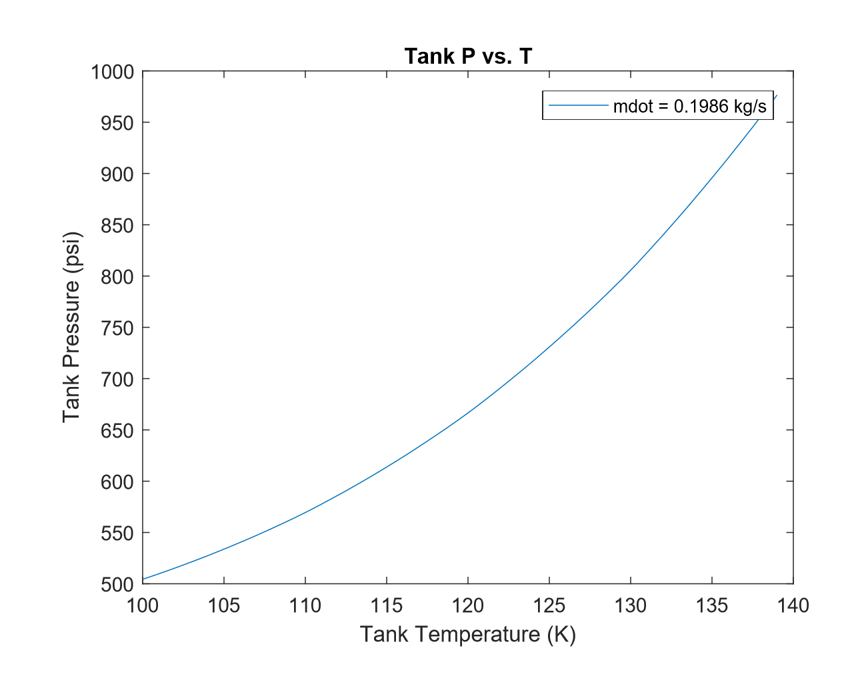
Venturi Dependence on Inlet Temperature

Slide 17
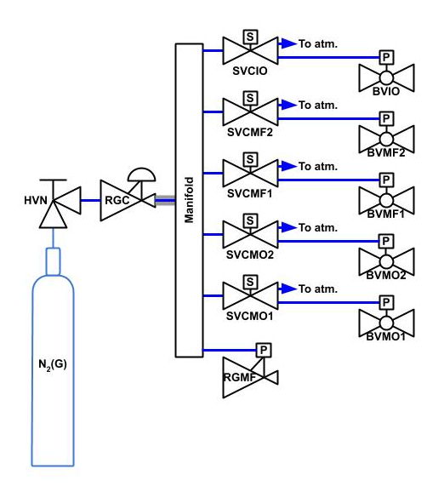
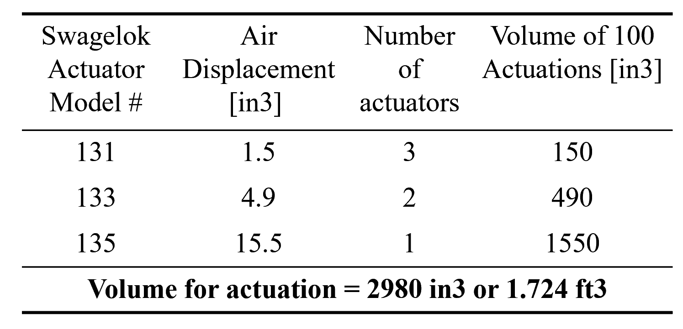
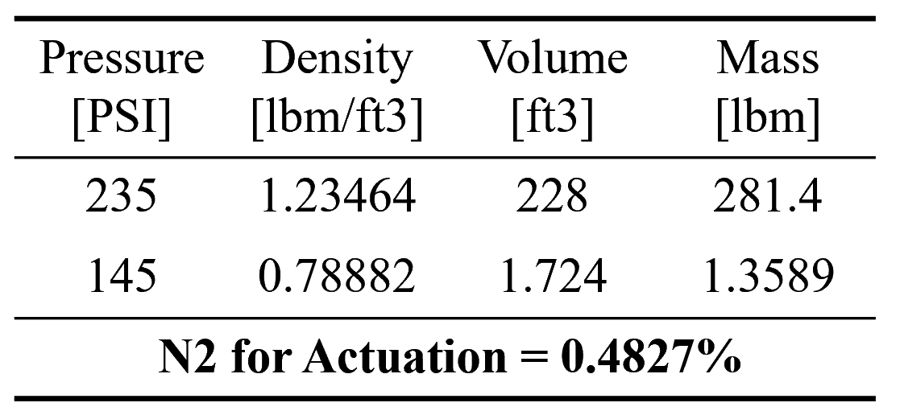
Pneumatic Controls
Bottled N2 now used to power pneumatically actuated valves instead of air compressor (avoids possible power supply issues during test).
Pressure regulated down to 100 psi and controlled using 2 position, 3 way solenoid valves.

Slide 18
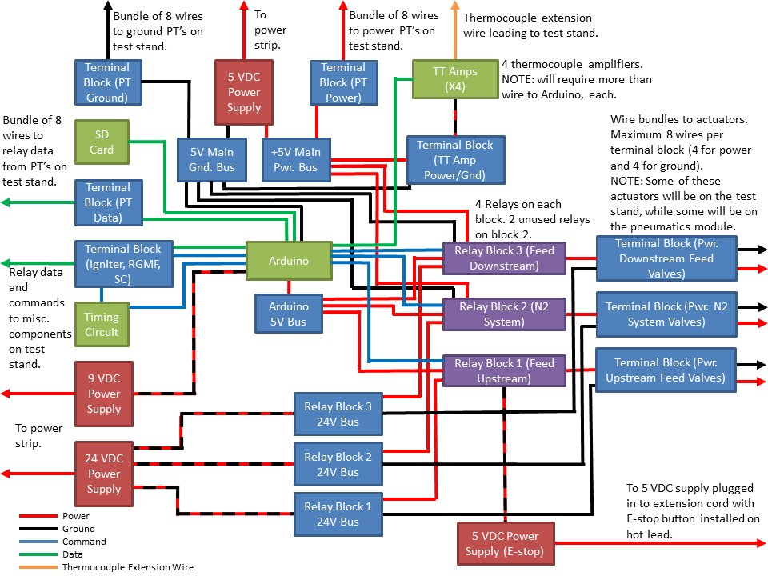
Electronics
Most of the electrical system will be mounted on a single board with terminal blocks or connectors to interface with the test stand.
The wiring will look like this except some of these lines are bundles of wires, not a single wire.

Slide 19
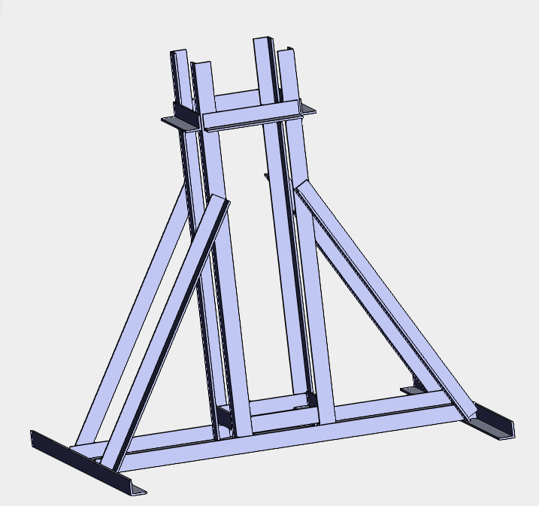
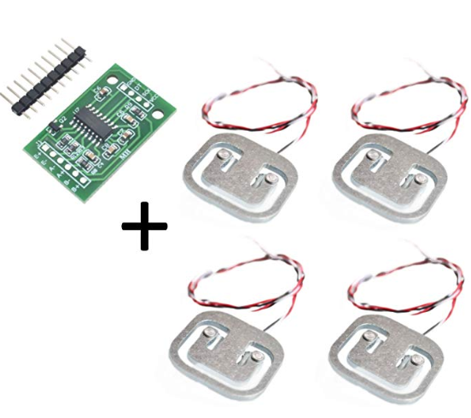
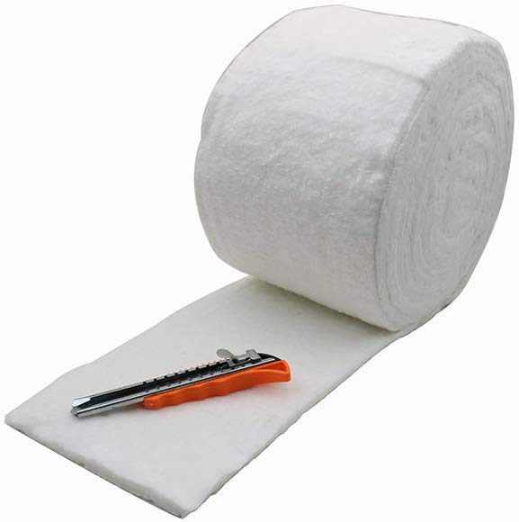
LOx Tank Mount & Insulation
4 load cells for monitoring run tank weight in real time
Load cells will be placed at the base of the tank support structure
Insulation using 0.4 inch thick ceramic fiber blanket & aluminum foil, held in place via cable ties & aluminum foil lined tape

Slide 20
Factors of Safety

Slide 21
Summary of Safety Factors
Component | Safety Factor
Igniter | >15
Igniter Screws | >11
Injector | 2
Tie Rods | 25
Nozzle Retainer Bolts | 2.6
Chamber Wall | 16
Nozzle End Flange | 2.8
Test Stand Support Plate | 10
¼-0.035” 316 Tube | 2.6 (@2000psi)
⅜-0.035” 316 Tube | 3.4 (@1000psi)
½-0.035” 316 Tube | 2.5 (@1000psi )

Slide 22
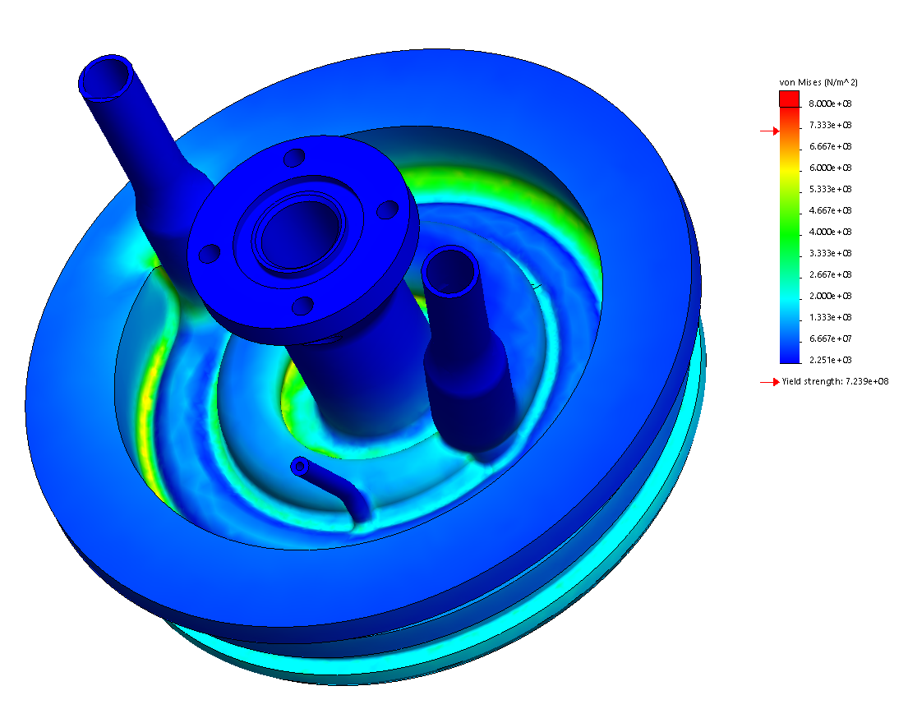
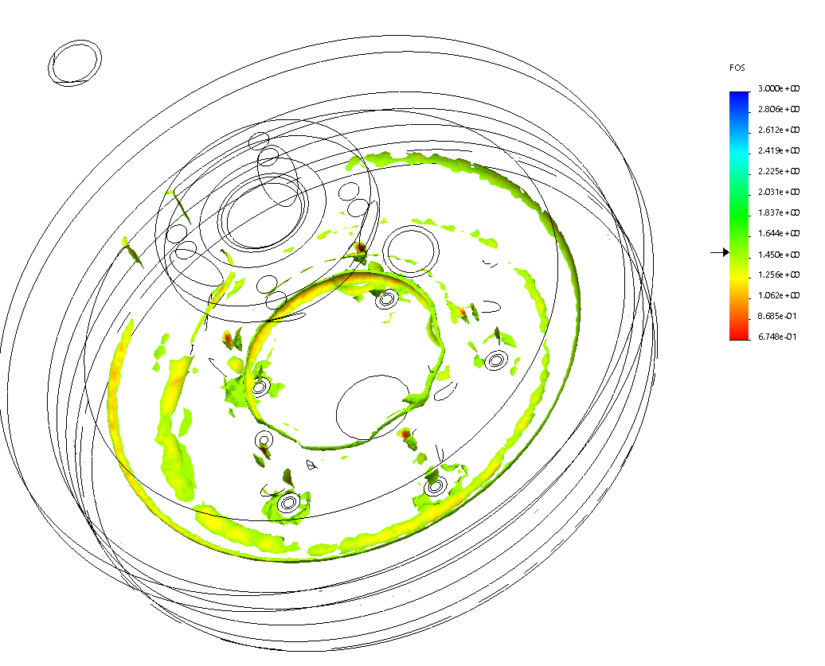
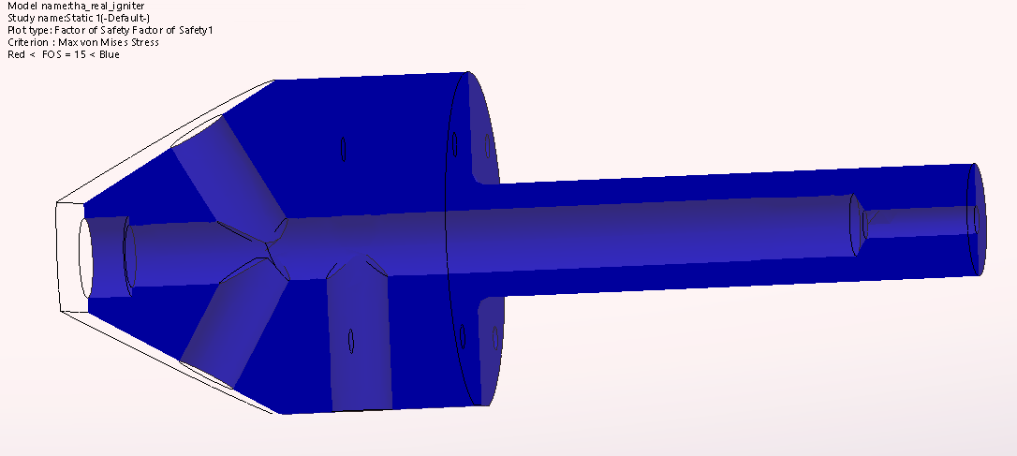
Injector/Igniter FEA
Injector
Pressures
150 psi on face
217 psi in manifold
Temperatures
500 K on face
Localized areas of low FS around LOx stream due to thermal stress, but large FS in bulk - May revisit before printing
Igniter
Pressure
200 psi
FS > 15

Slide 23
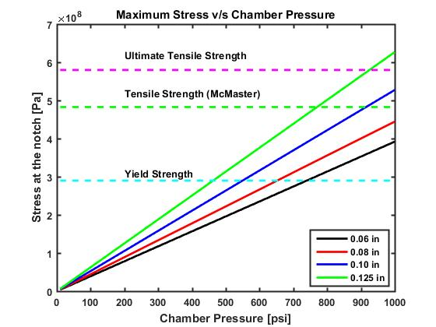
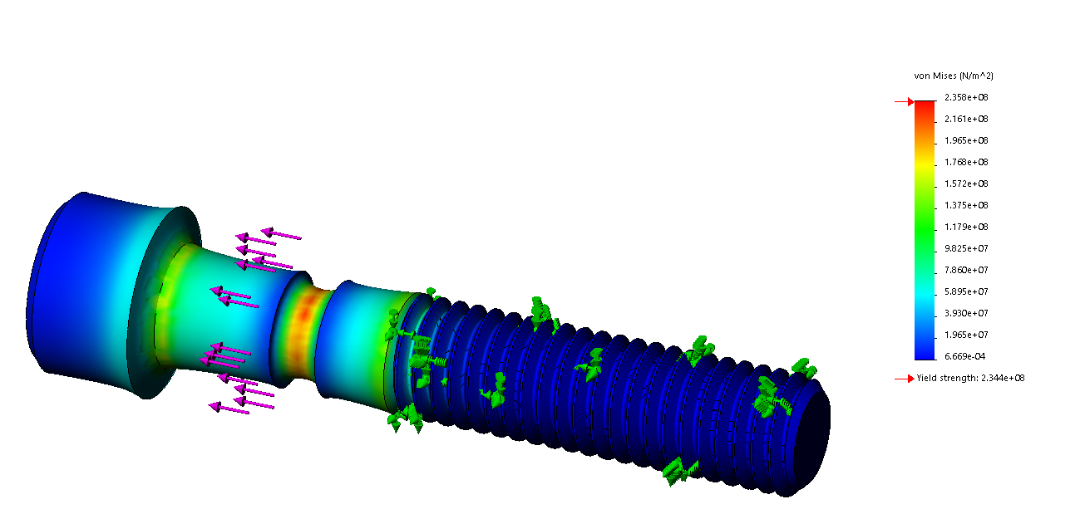
Combustion Chamber Overpressure Relief
FEA simulations confirmed with hand calculations
0.06 in notch depth will lead to failure at 800 psi
316 stainless steel screws
FEA
Hand Calculation

Slide 24
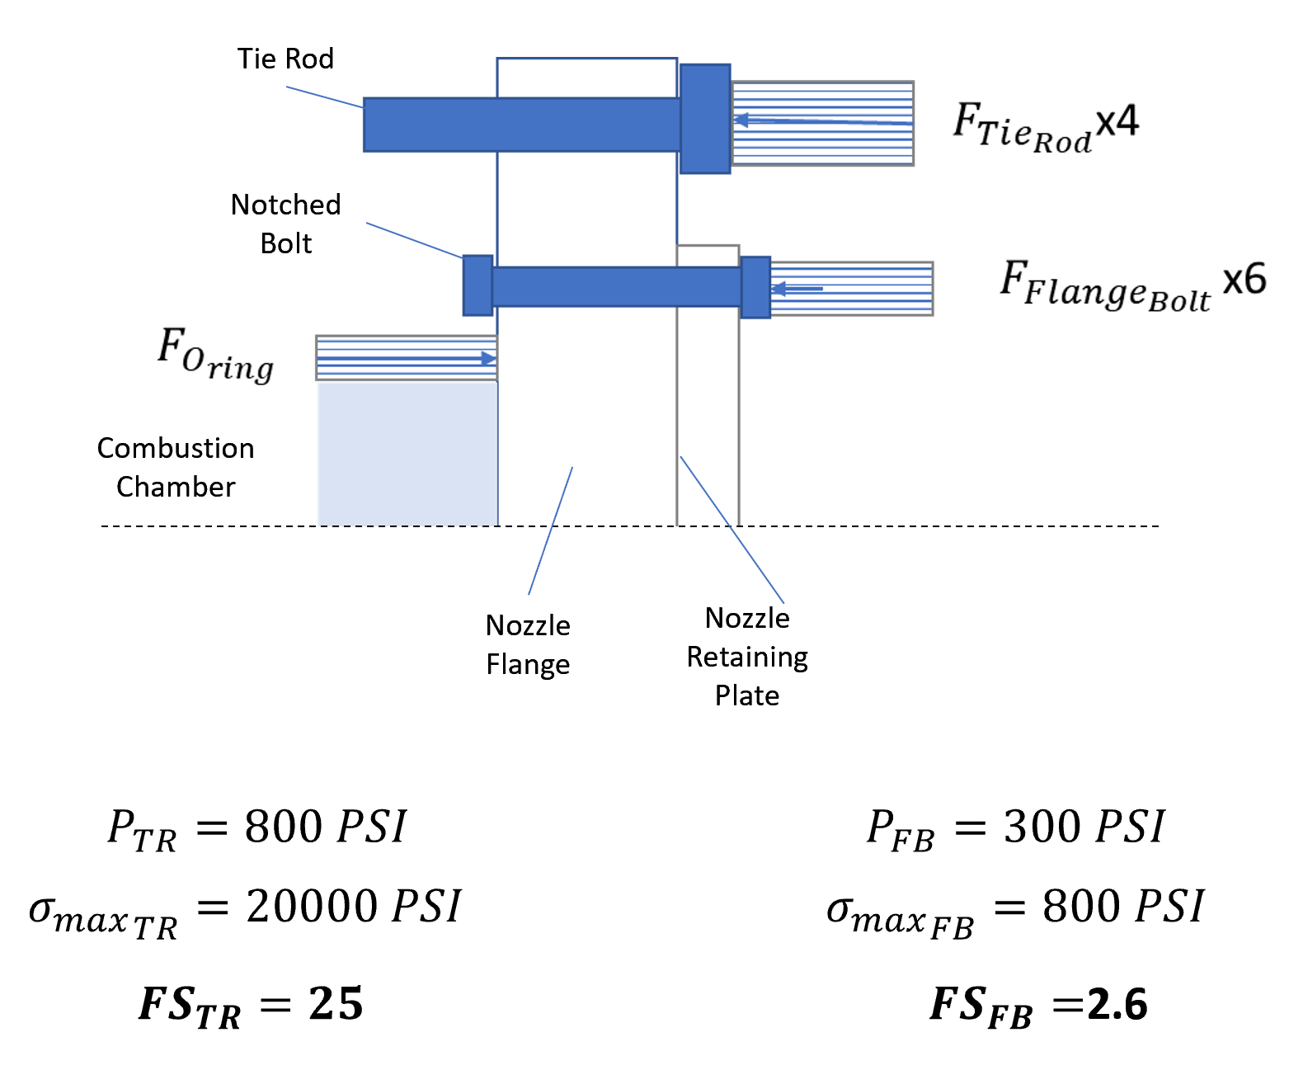
Factor of Safety
Hand calculations confirmed the current setup can withstand the operating chamber pressure of 150 PSI.
Assumptions:
Pressure distributions modelled as point loads on a cantilever beam.

Slide 25
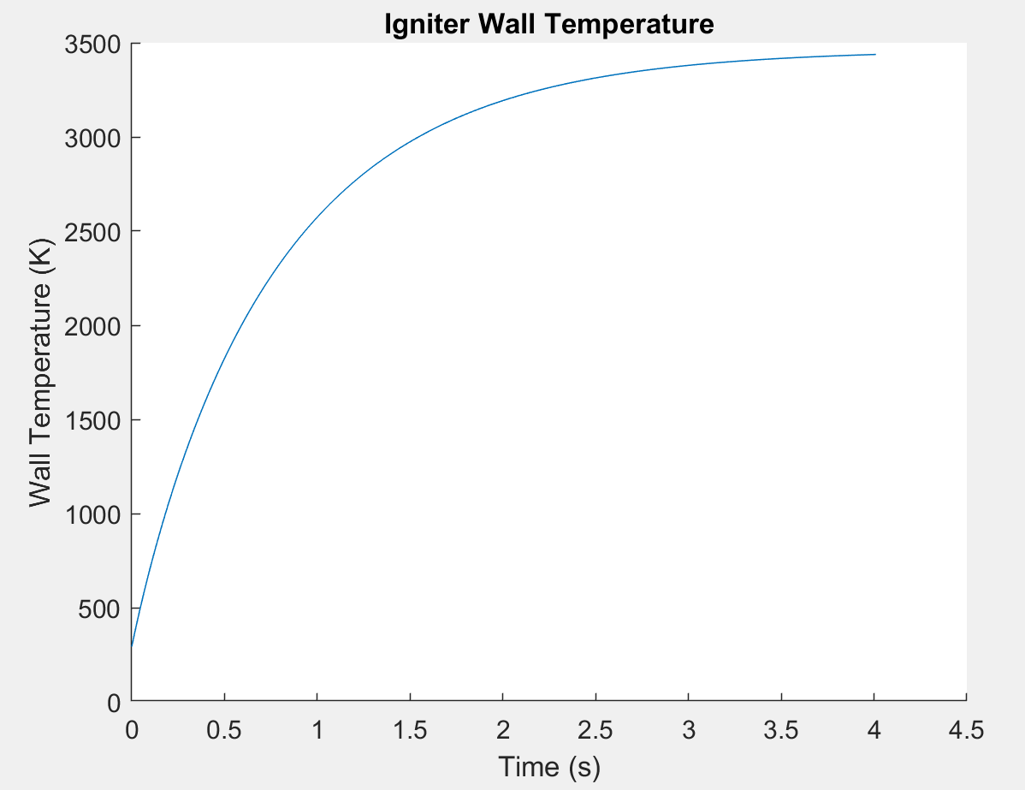
Igniter Heat Transfer Estimate
Treated igniter chamber as a simple tube, with the following flow characteristics
Internal forced convection from flow at 3464 K from CEA
Weighted average Cp and viscosity of flow from CEA
External natural convection
Ignore conduction resistance
Forced Convection
Sieder and Tate Relation due to high dT
Natural Convection
Empirical horizontal pipe
Energy difference results in dT of wall

Slide 26
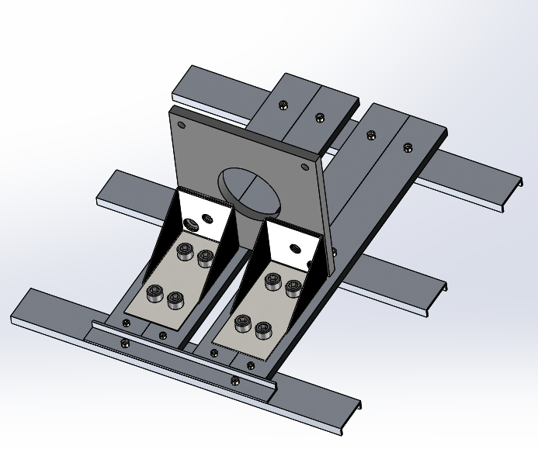
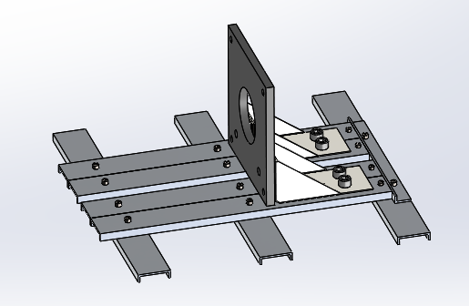
Test Stand
Changes from PDR:
No welds
Corner brackets are rated for 500 lbs each, FoS = 10
Removed backplate of combustion chamber assembly to reduce weight and cost
Cost: $277.92
Materials: HomeDepot and MetalsDepot (2 day delivery time)
Manufacturing: Drilling holes, CNC back plate -> lead time: 1 week

Slide 27
Budget & Fabrication

Slide 28
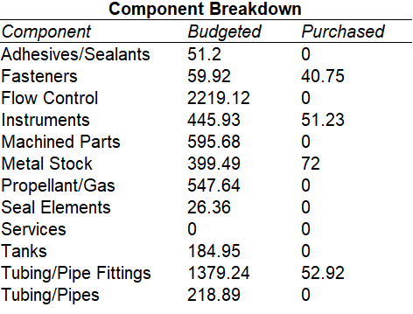
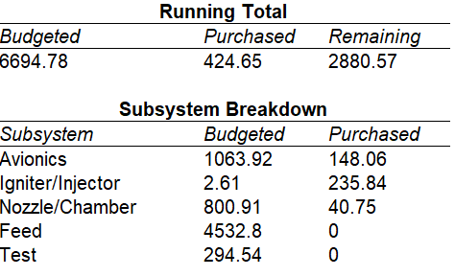
Budget
https://docs.google.com/spreadsheets/d/1Akb-G0P3gi-R2JIjckR0jrPFSVN0DPMDoXRMupv_SYY/edit#gid=676738434

Slide 29
Fabrication
Custom Part | Fabrication Method | Supplier/Shop | Cost
Injector | DMP & Post-Machined | Protolabs | Sponsored
Igniter | Machined | PRL | Materials
Cavitating Venturi | Machined | PRL | Materials
Combustion Chamber | Machined | Pending | Pending
Nozzle Retaining (Notched) Bolts | Machined | PRL | Materials
Nozzle | Machined | Electro Tech Machining | ~$198 ea. for 3
Nozzle End Flange | Machined | Pending | Pending
Nozzle Retaining Plate | Waterjet | PRL | Materials
Test Stand Support Plate | Waterjet | PRL | Materials

Slide 30
Revised Test Plan & Schedule

Slide 31
Test Plan
Subsystem tests
Igniter test (needs to re-ignite for this mission)
Test igniter under operating conditions
Determine ignition timing, test control software, size of igniter throat
Determine igniter jet-penetration distance for the chosen operating pressure
Series of tests
Ignite the igniter propellant in open air
Measure pressure rise in combustion chamber with no oxidizer flow
Hydro testing of pressure vessels
Manufacture components tested to 1.5 MAWP, holding pressure for 10 min
Fill test component with water
Procedure
Seal off pressure vessel except for a single entry port (Designs for the Aluminium plug for the combustor ready)
Fill the vessel with deionized water
Orient the chamber to eliminate the presence of trapped air
Use a hydraulic pump cart to bring it up to a pre-determined test pressure
Hold pressure for an amount of time and visually inspect for leaks

Slide 32
Test Plan
Subsystem tests
Cold flow test
Confirm that oxidizer mass rate matches the design objective
Load rocket with oxidizer and vent, no igniter installed
Adjust tank pressure to tune oxidizer mass flow rate
Procedure
Setup air feed supply
Avionics startup, data acquisition, shutdown
Full system test
Single (5 second) burn
2 burns back-to-back
Three burns back-to-back

Slide 33
Assembly Drawings

Slide 34
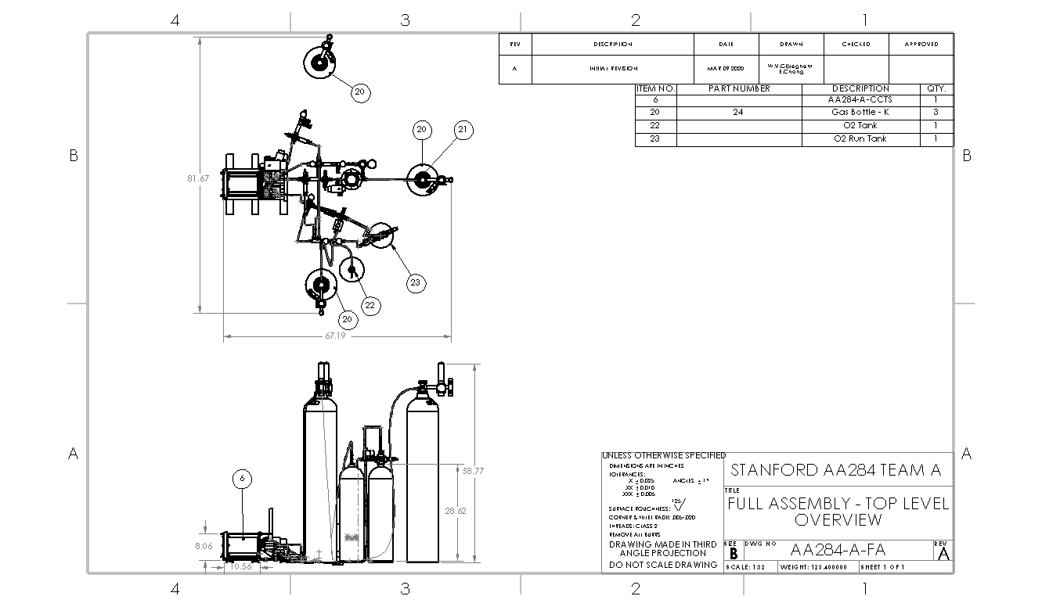

Slide 35
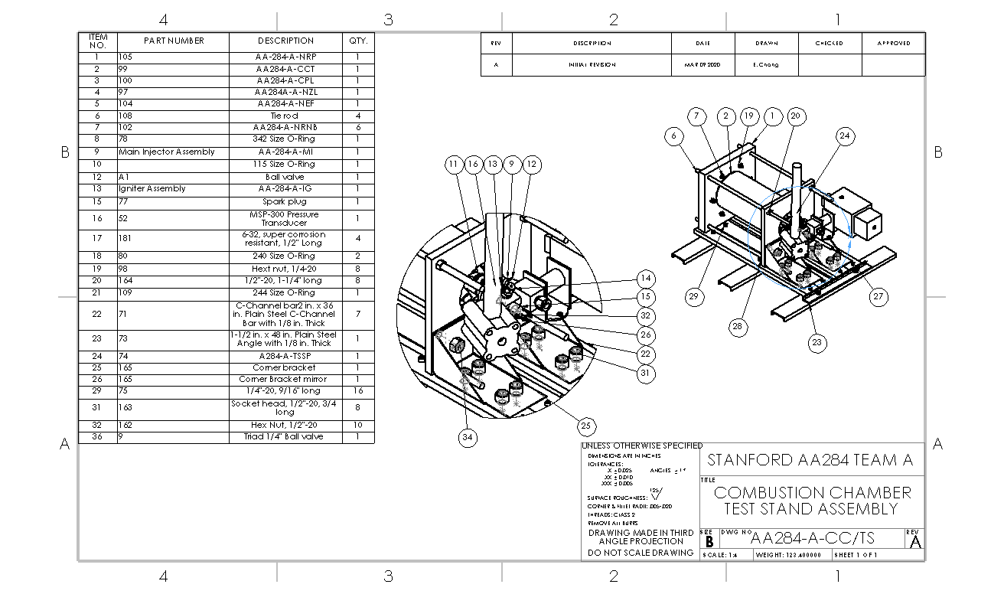

Slide 36
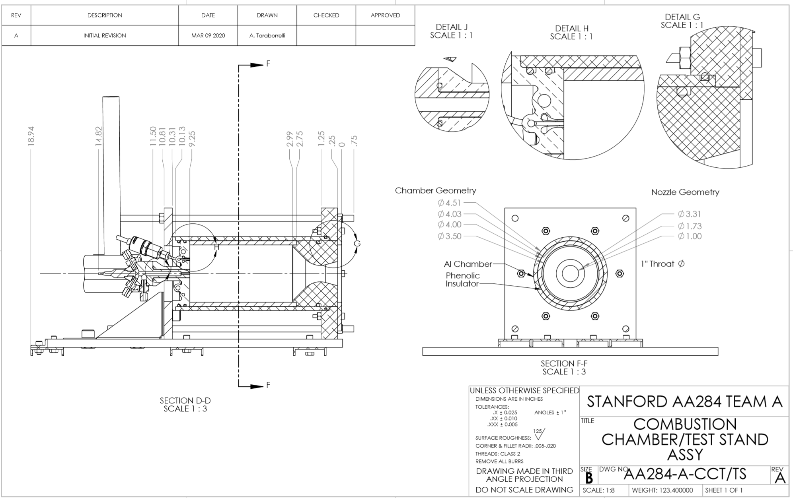

Slide 37
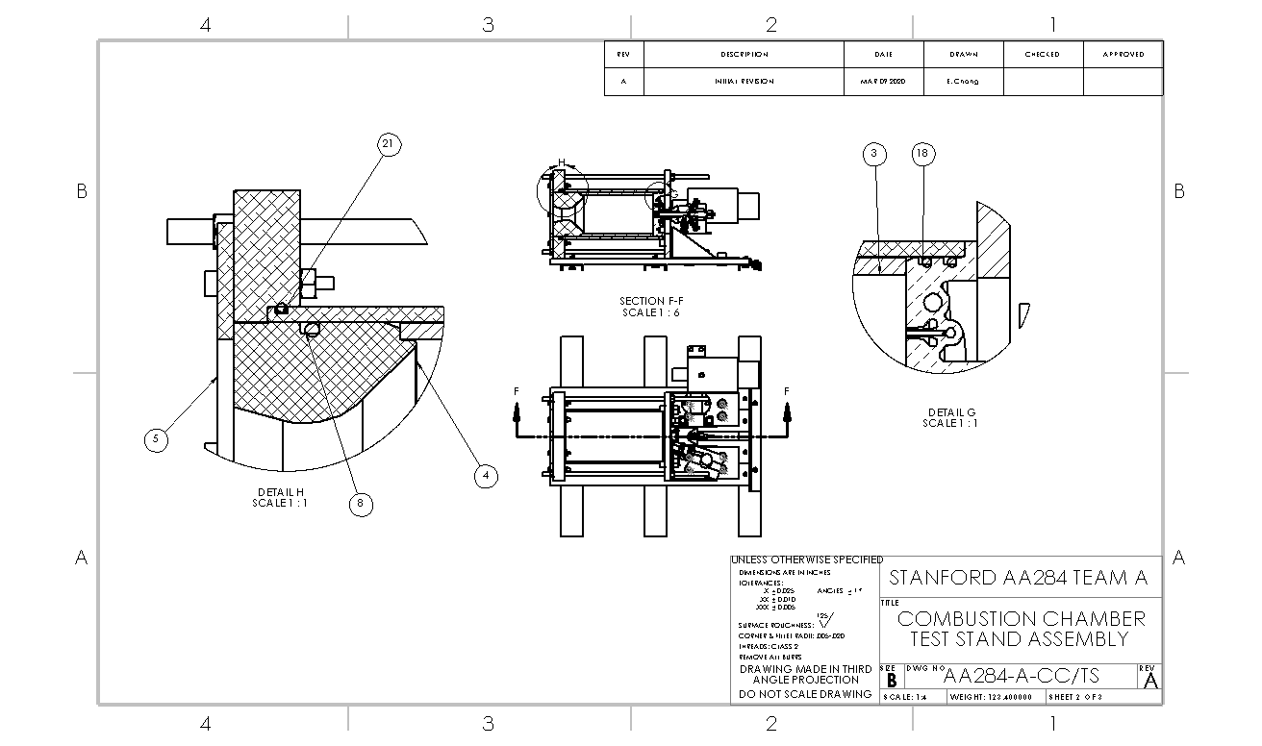

Slide 38
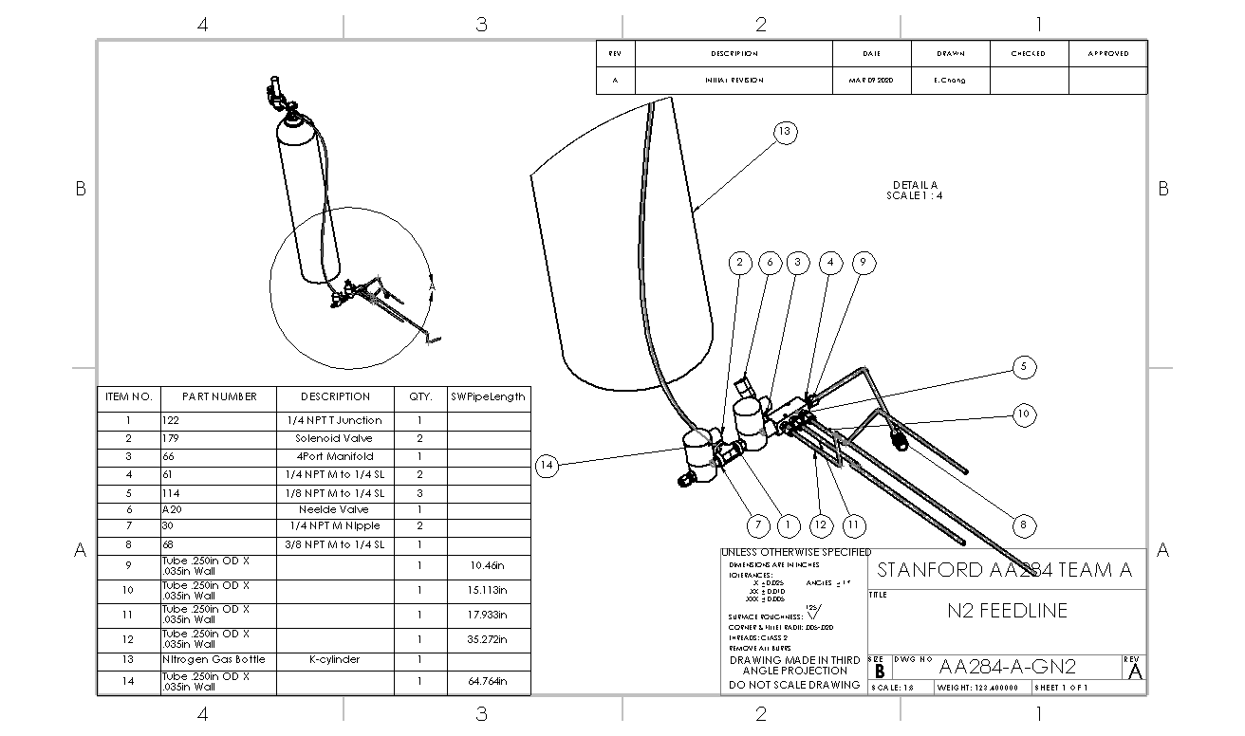

Slide 39
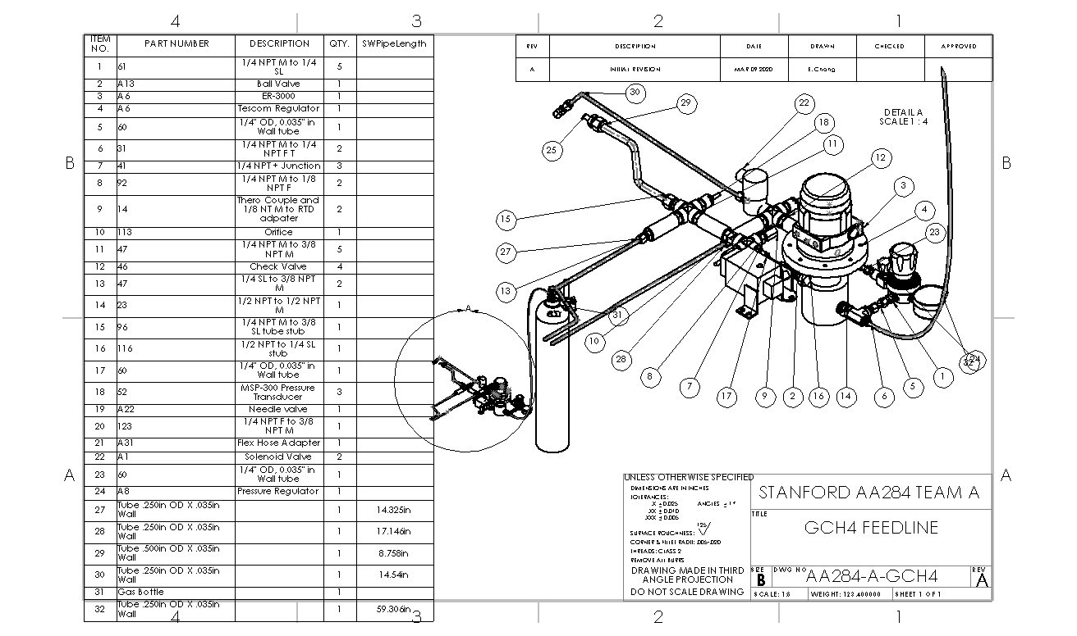

Slide 40
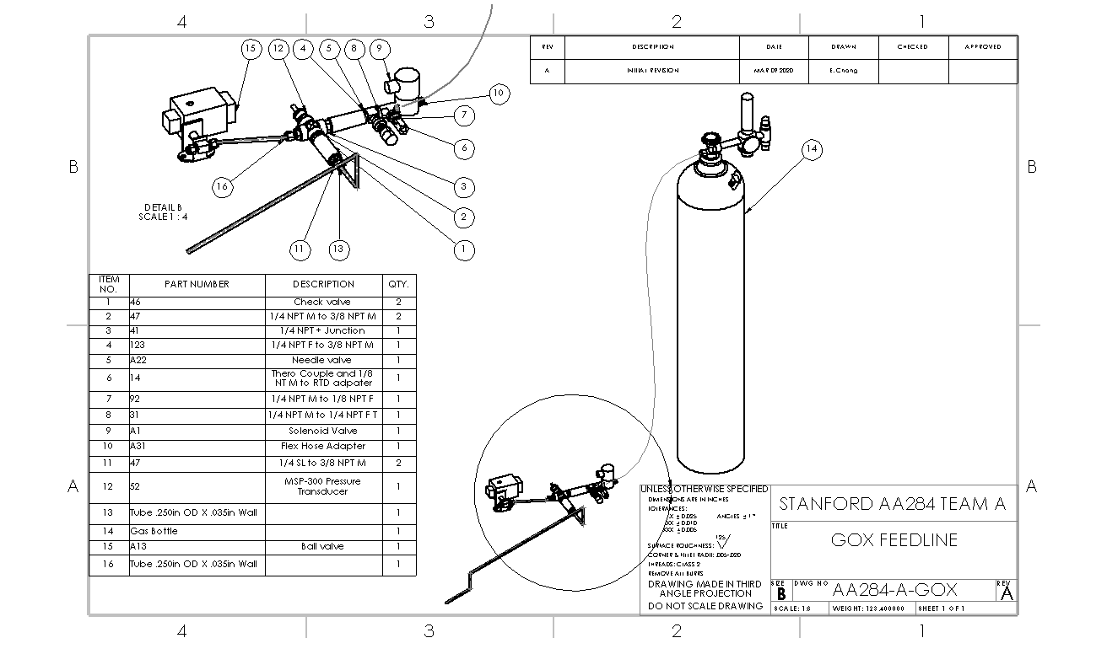

Slide 41
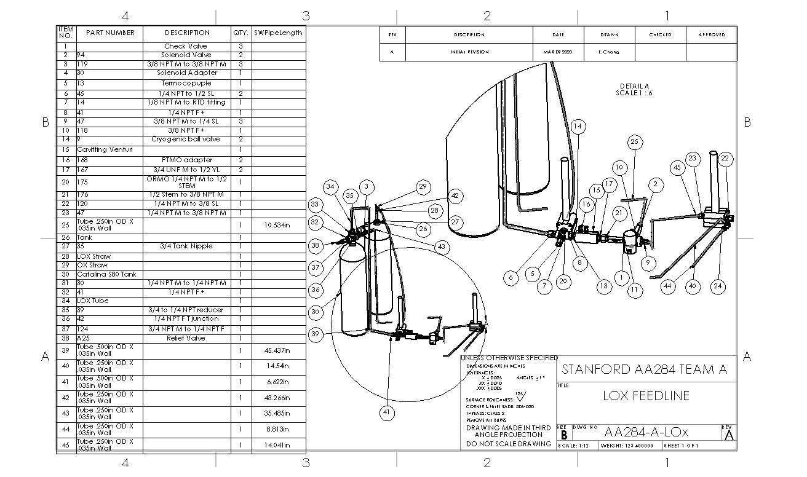

Slide 42
Component Drawings

Slide 44
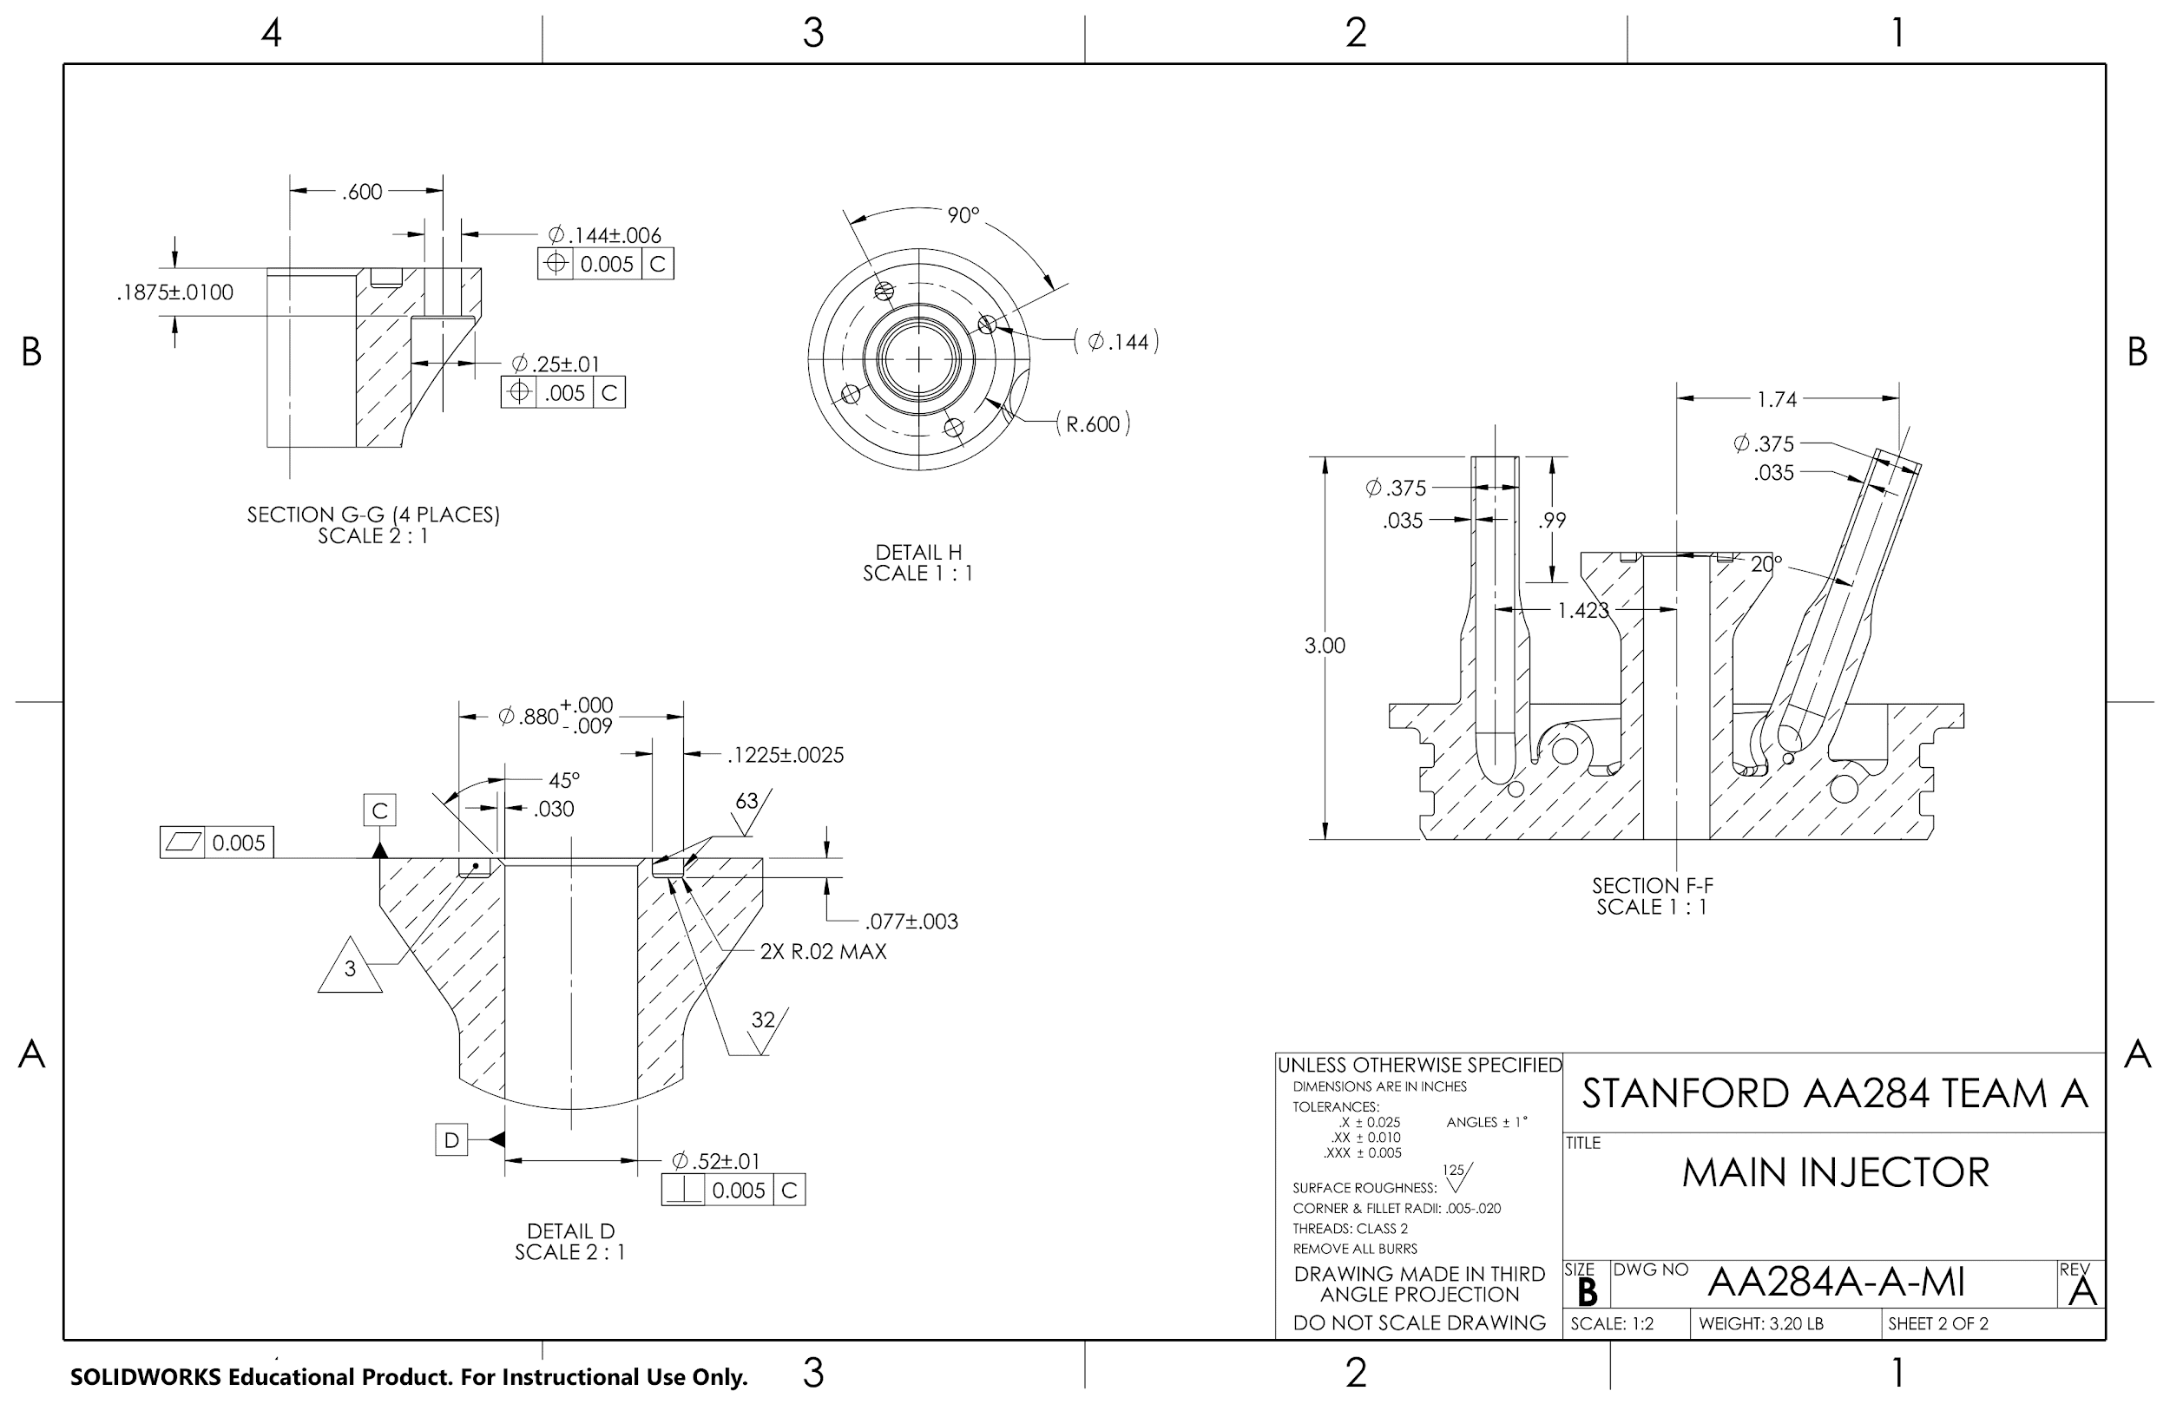

Slide 45
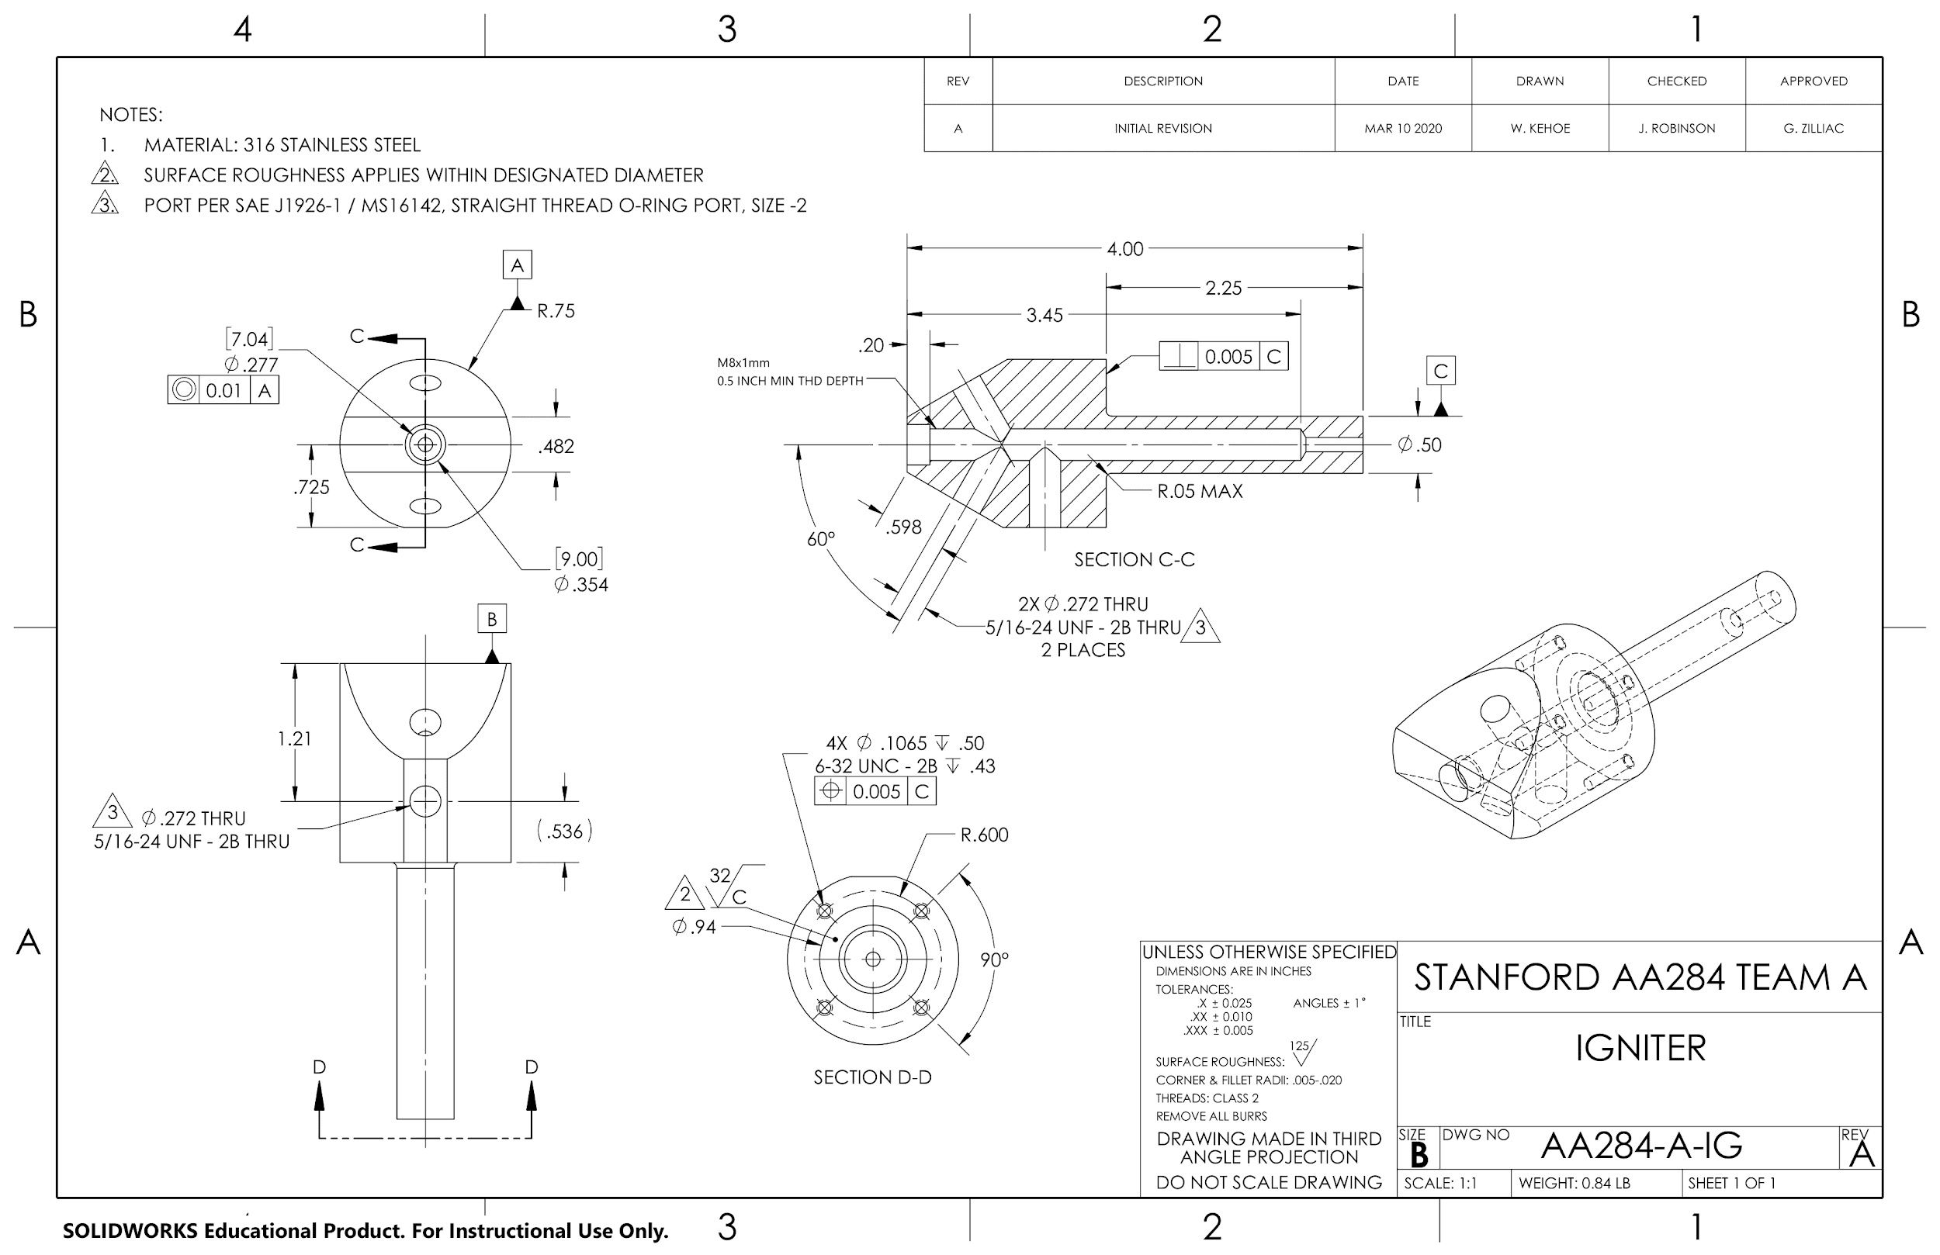

Slide 46
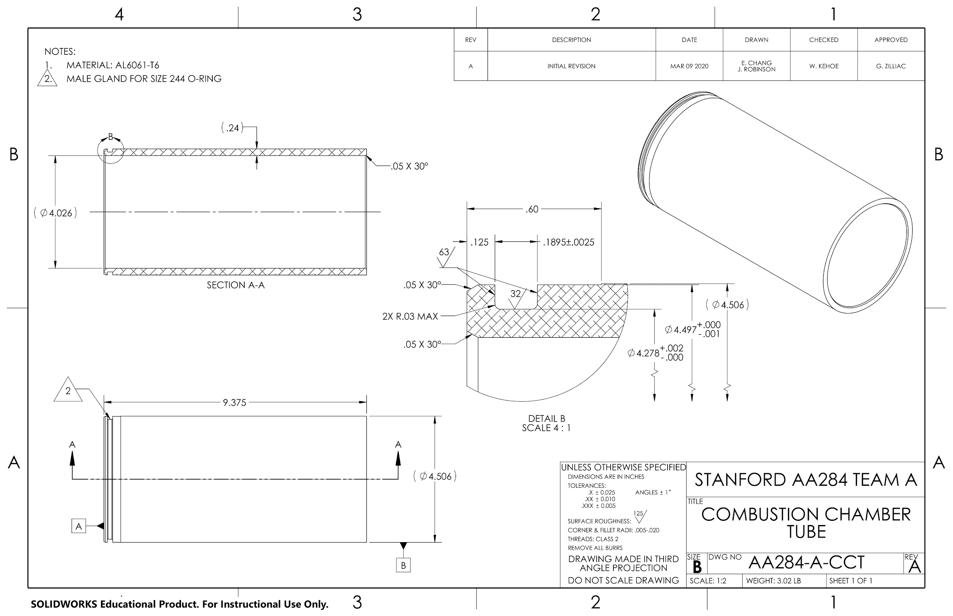

Slide 47
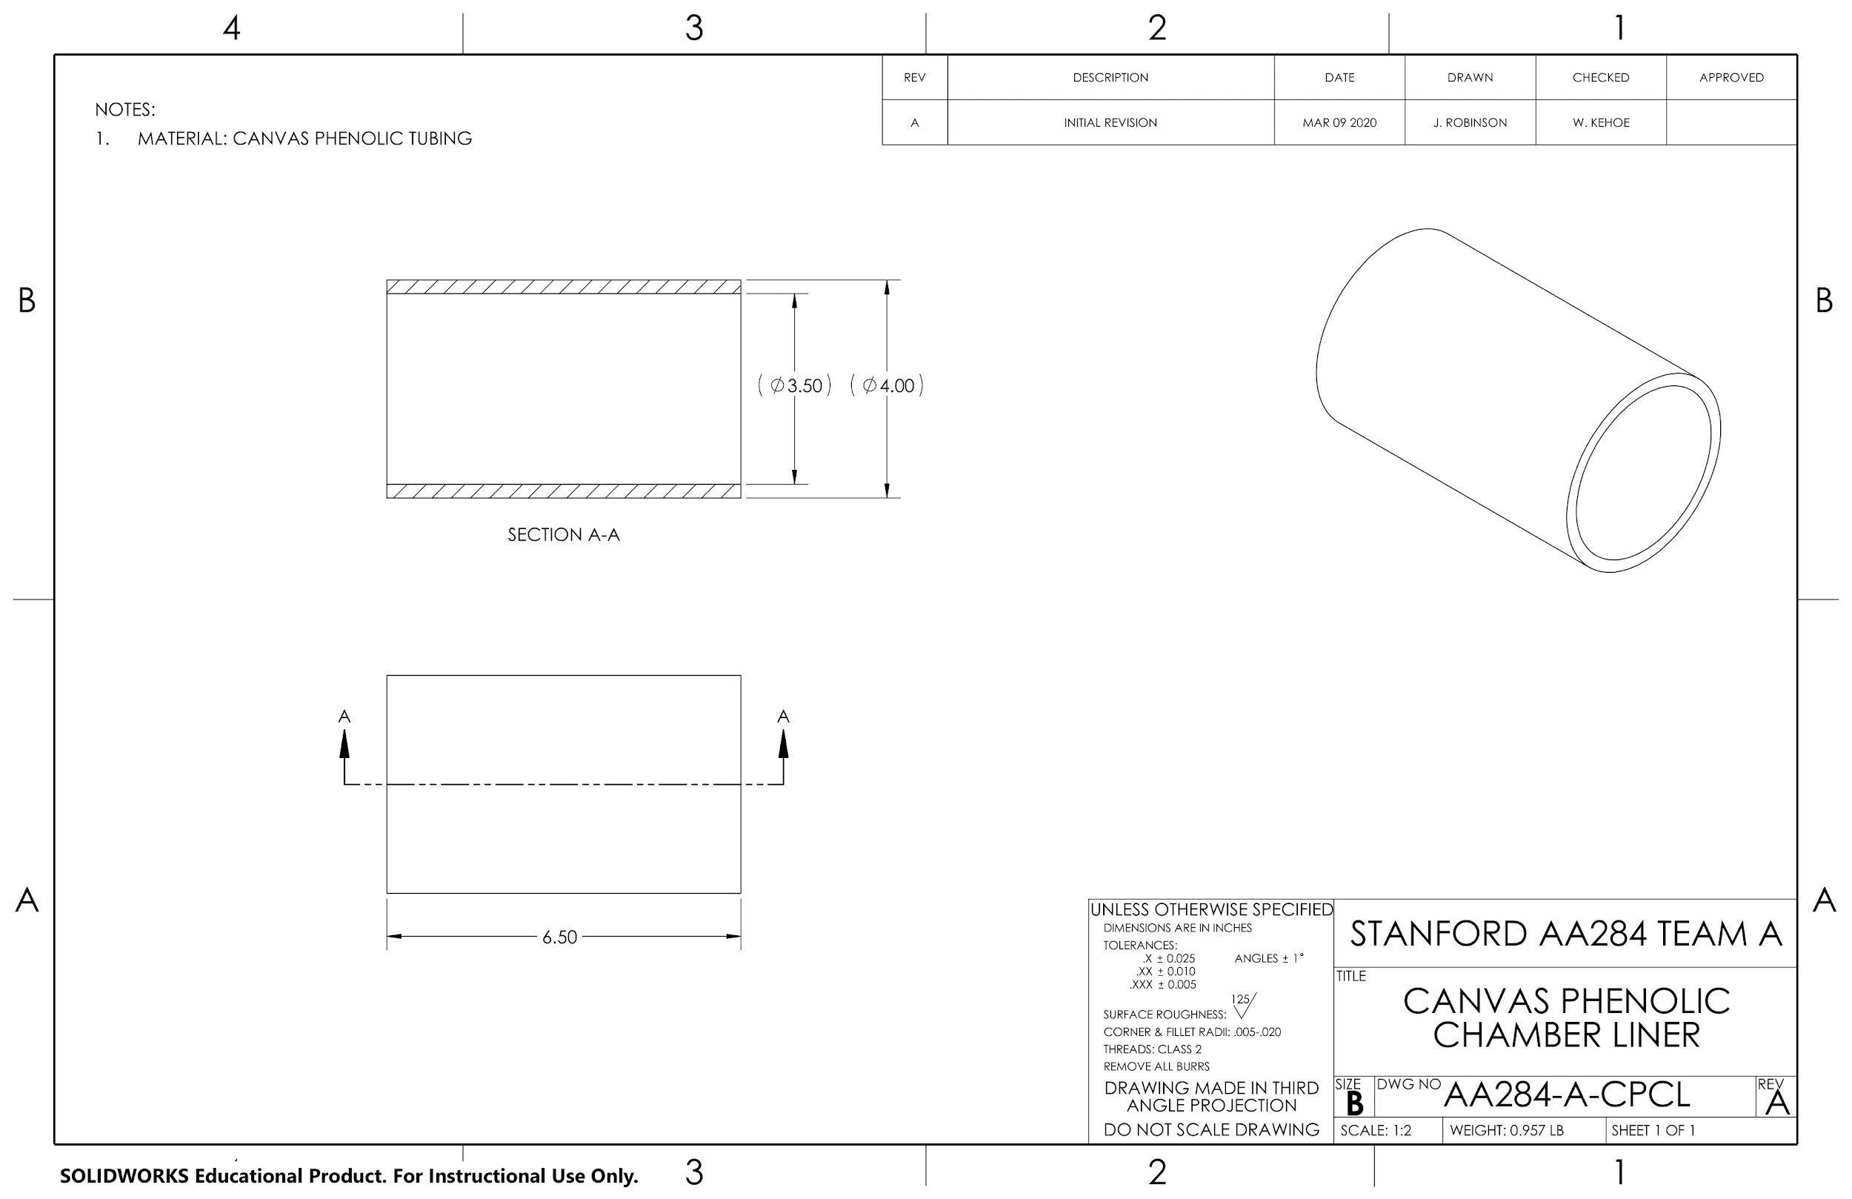

Slide 48
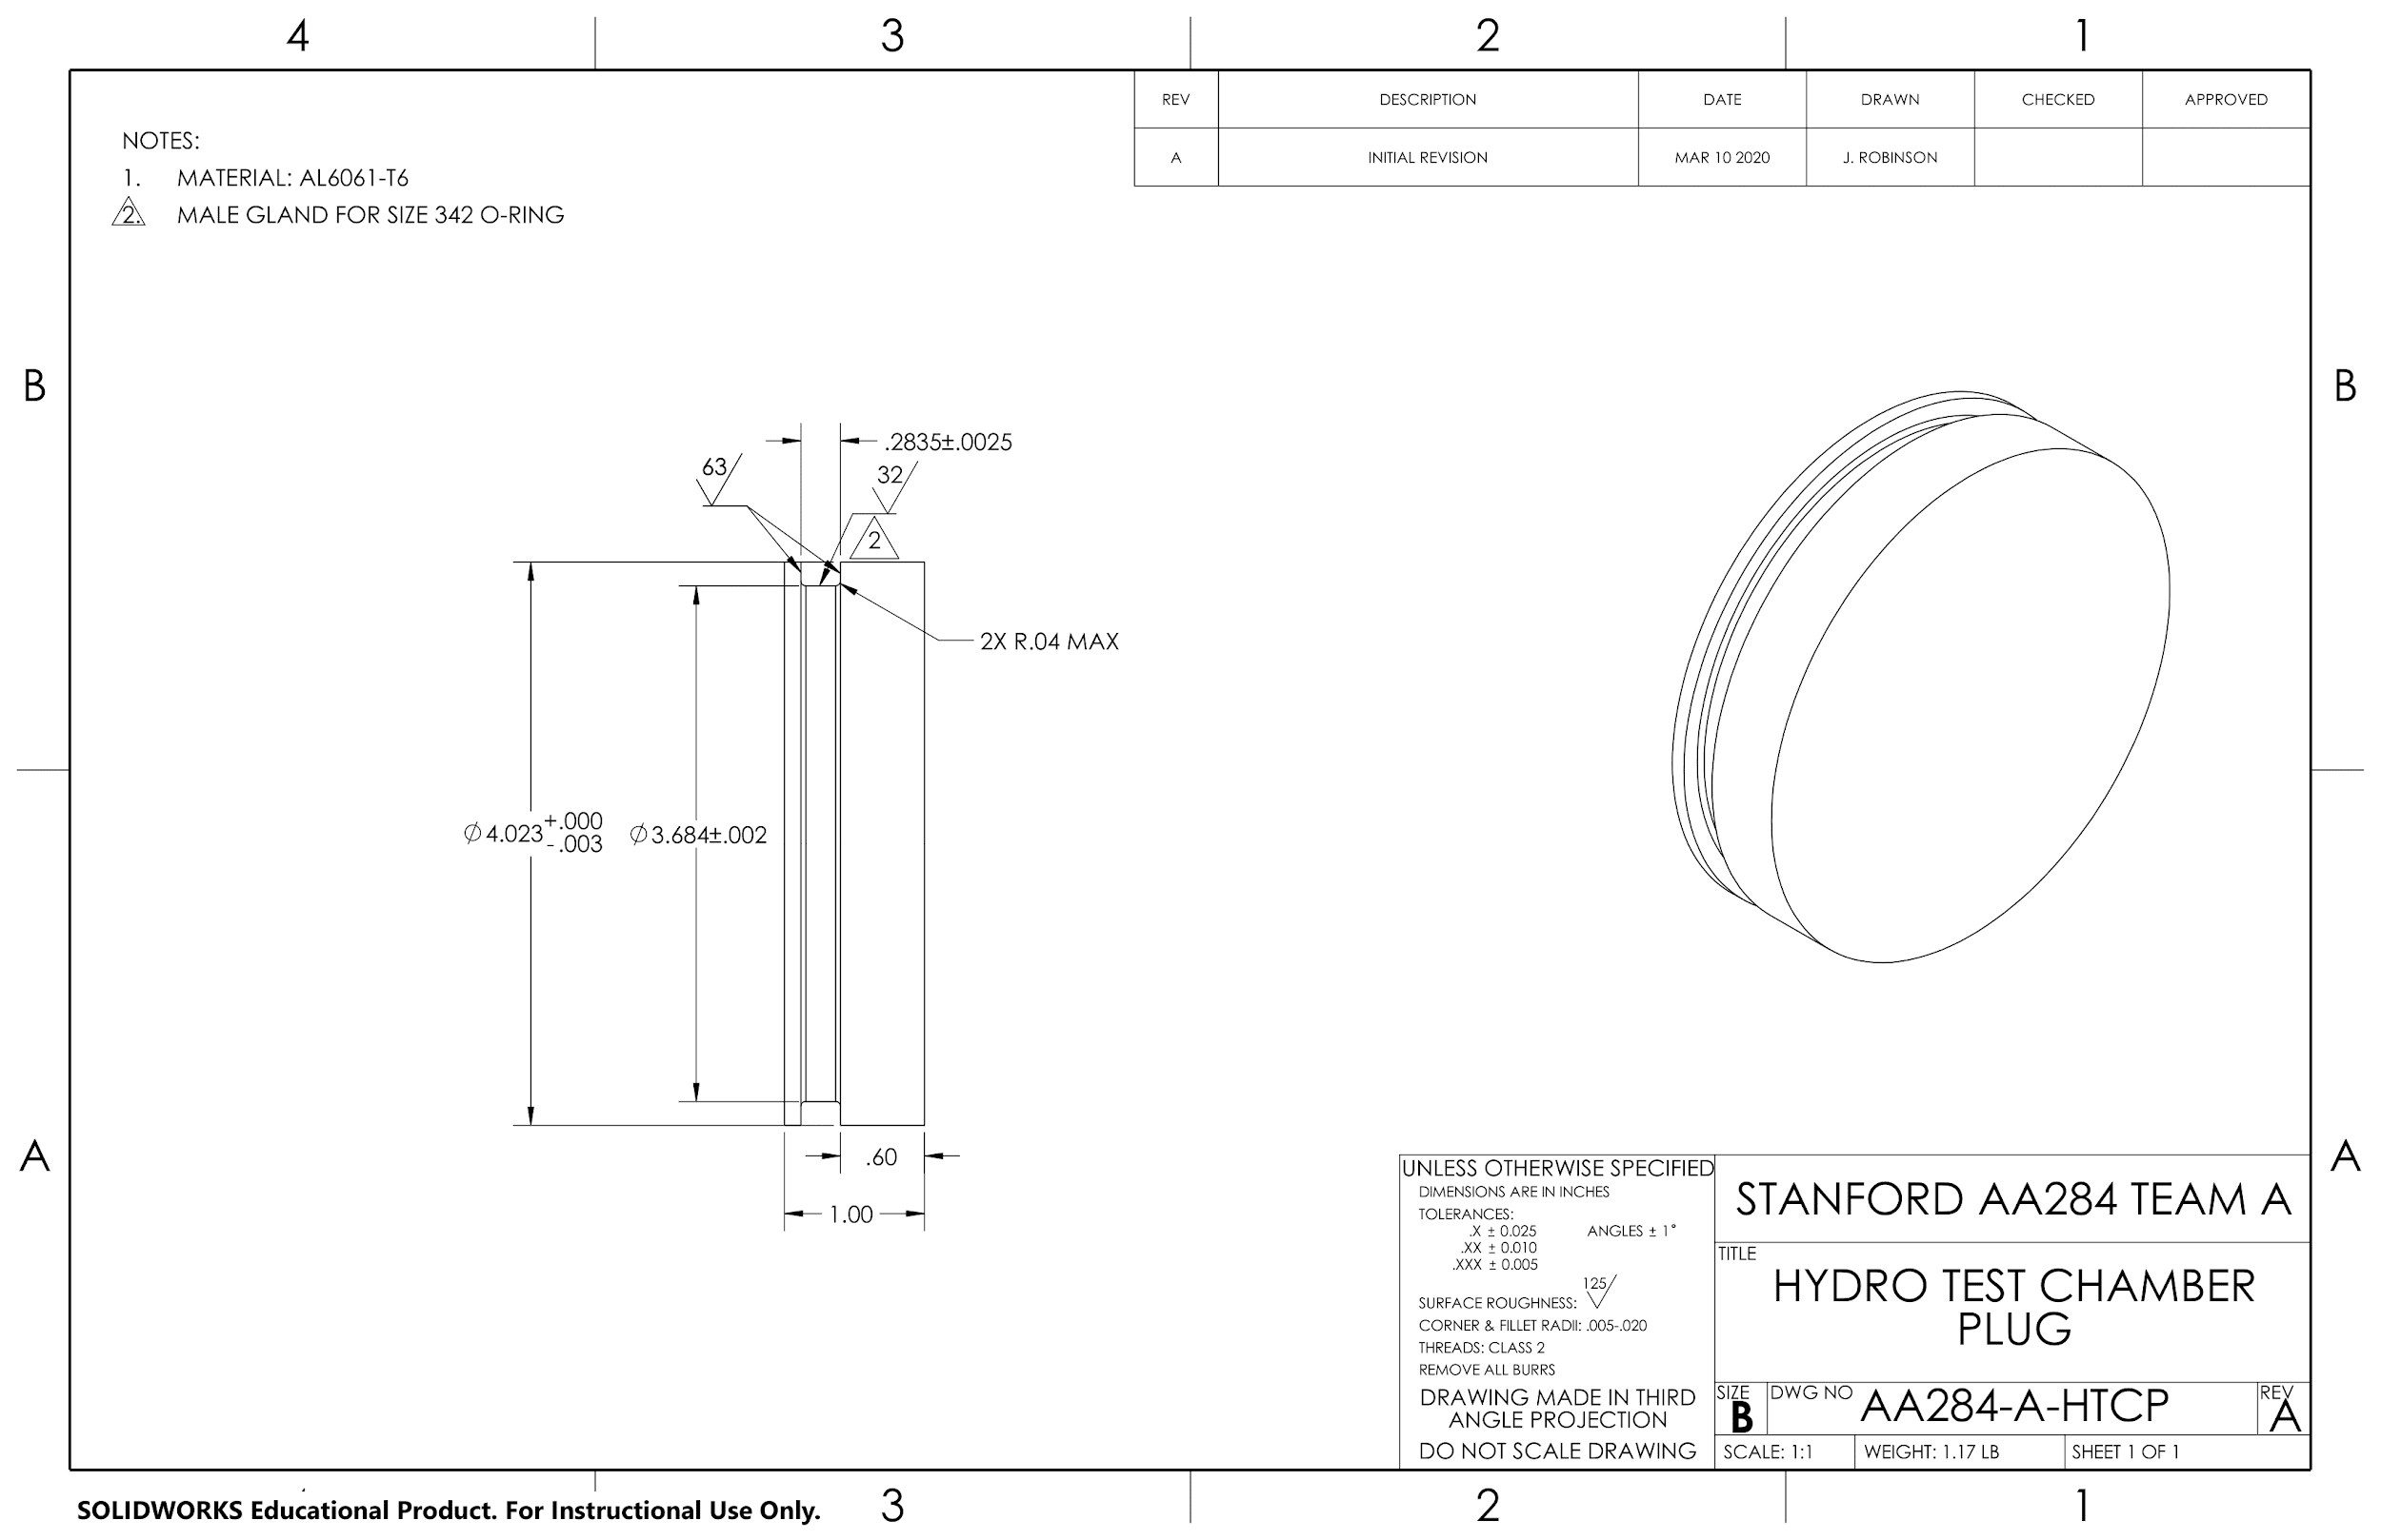

Slide 49
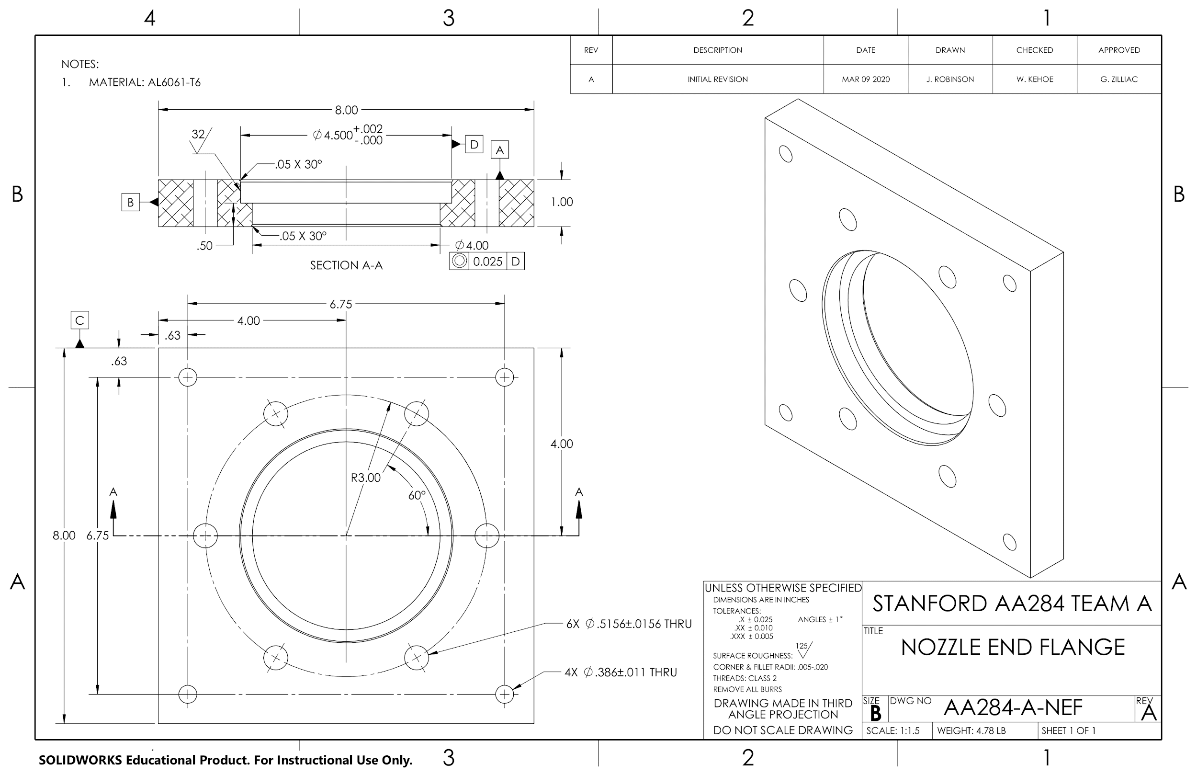

Slide 50
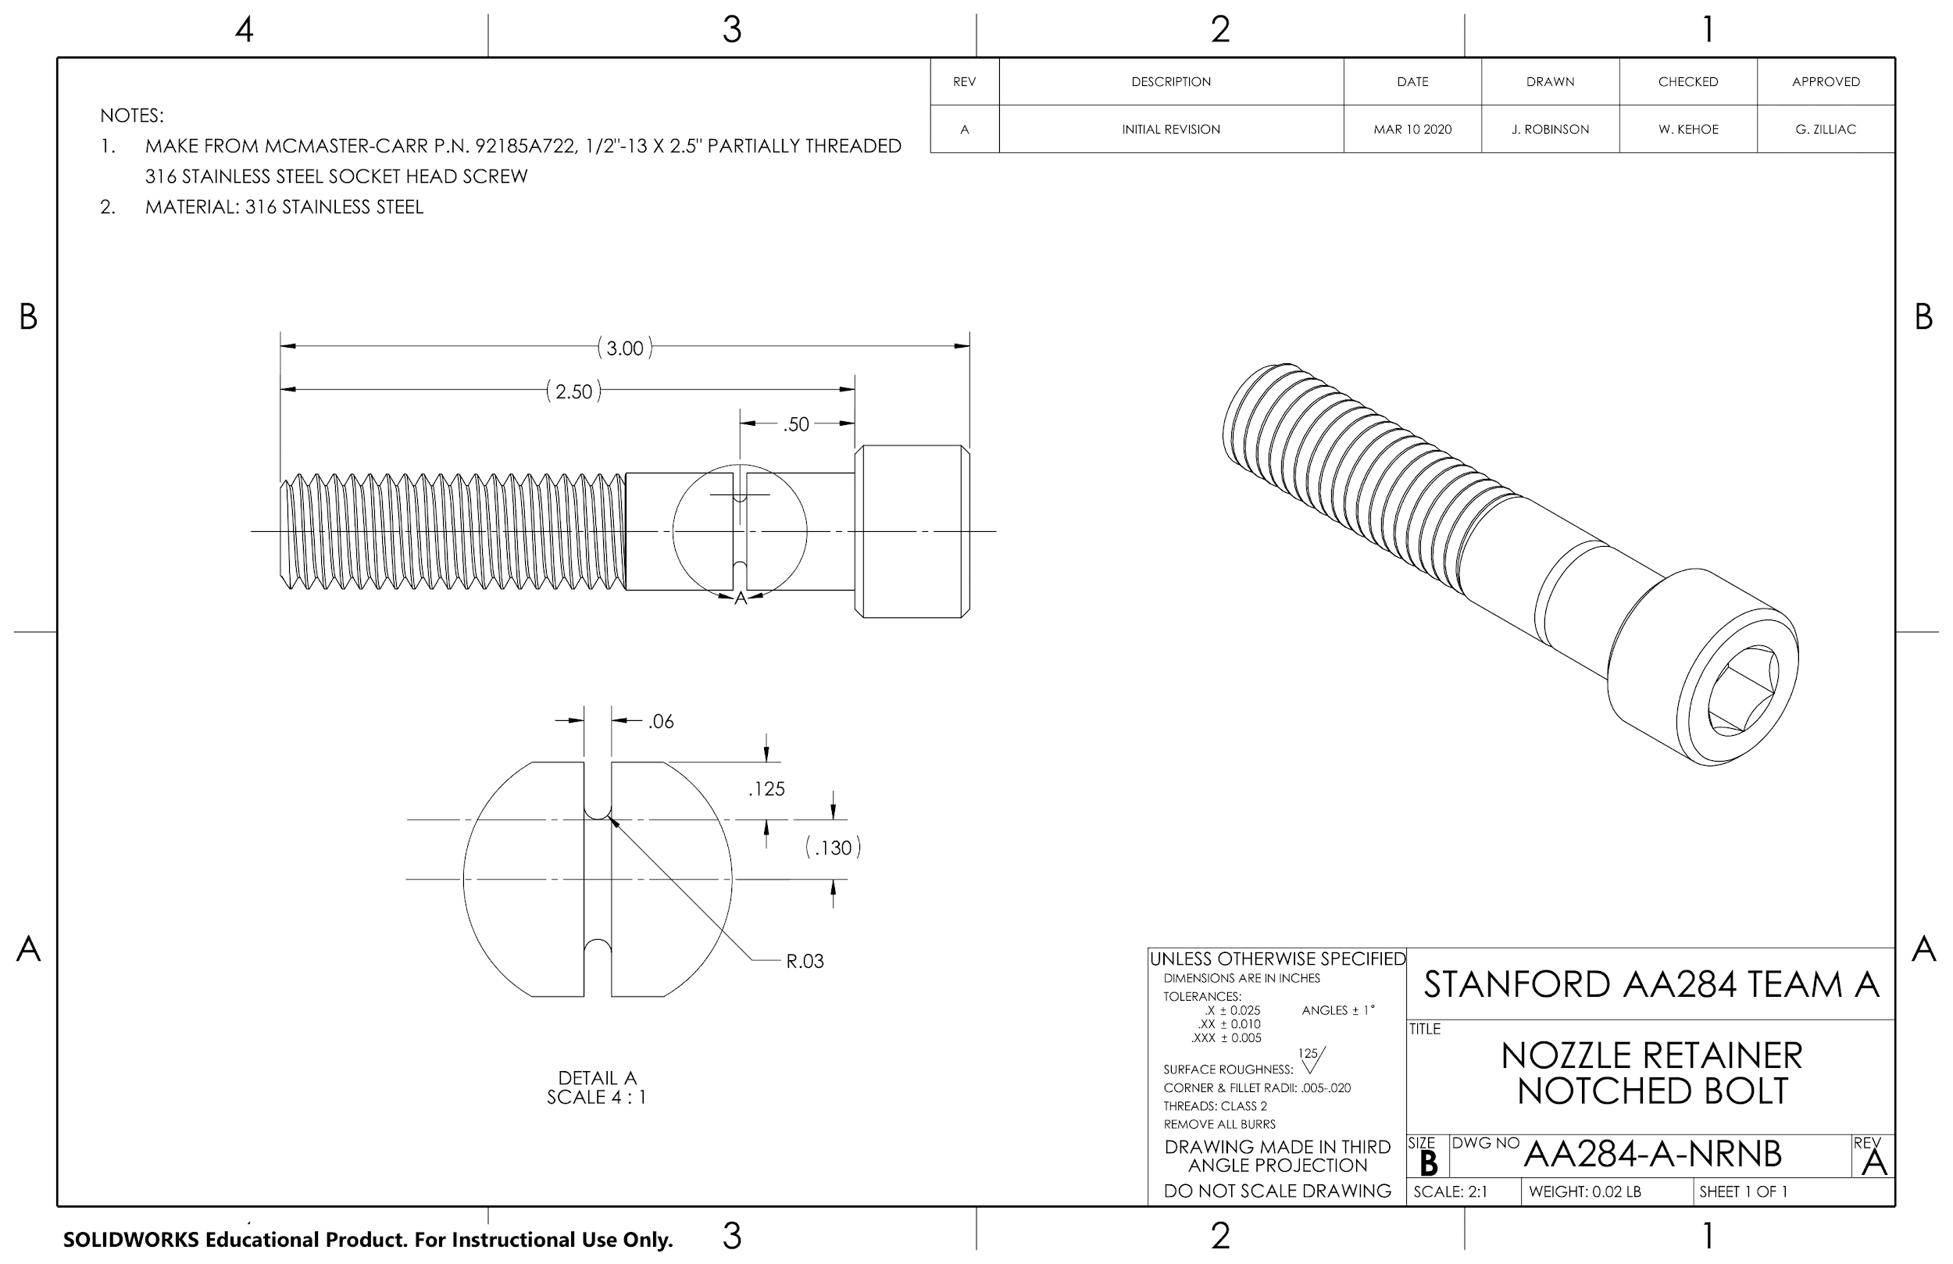

Slide 51
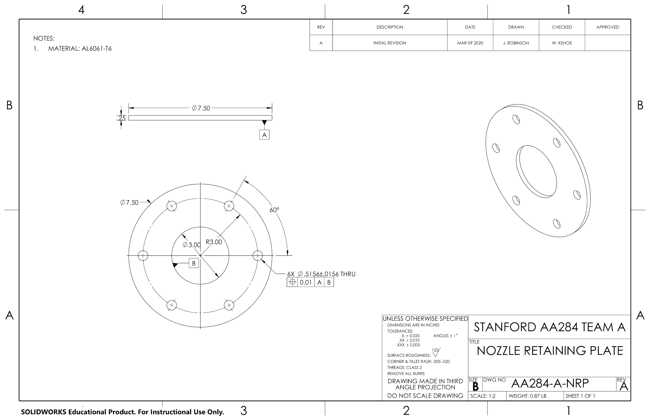

Slide 52
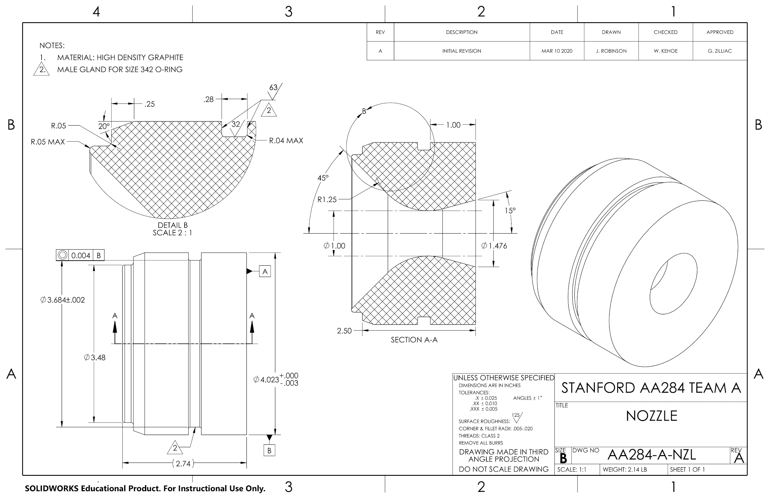

Slide 53
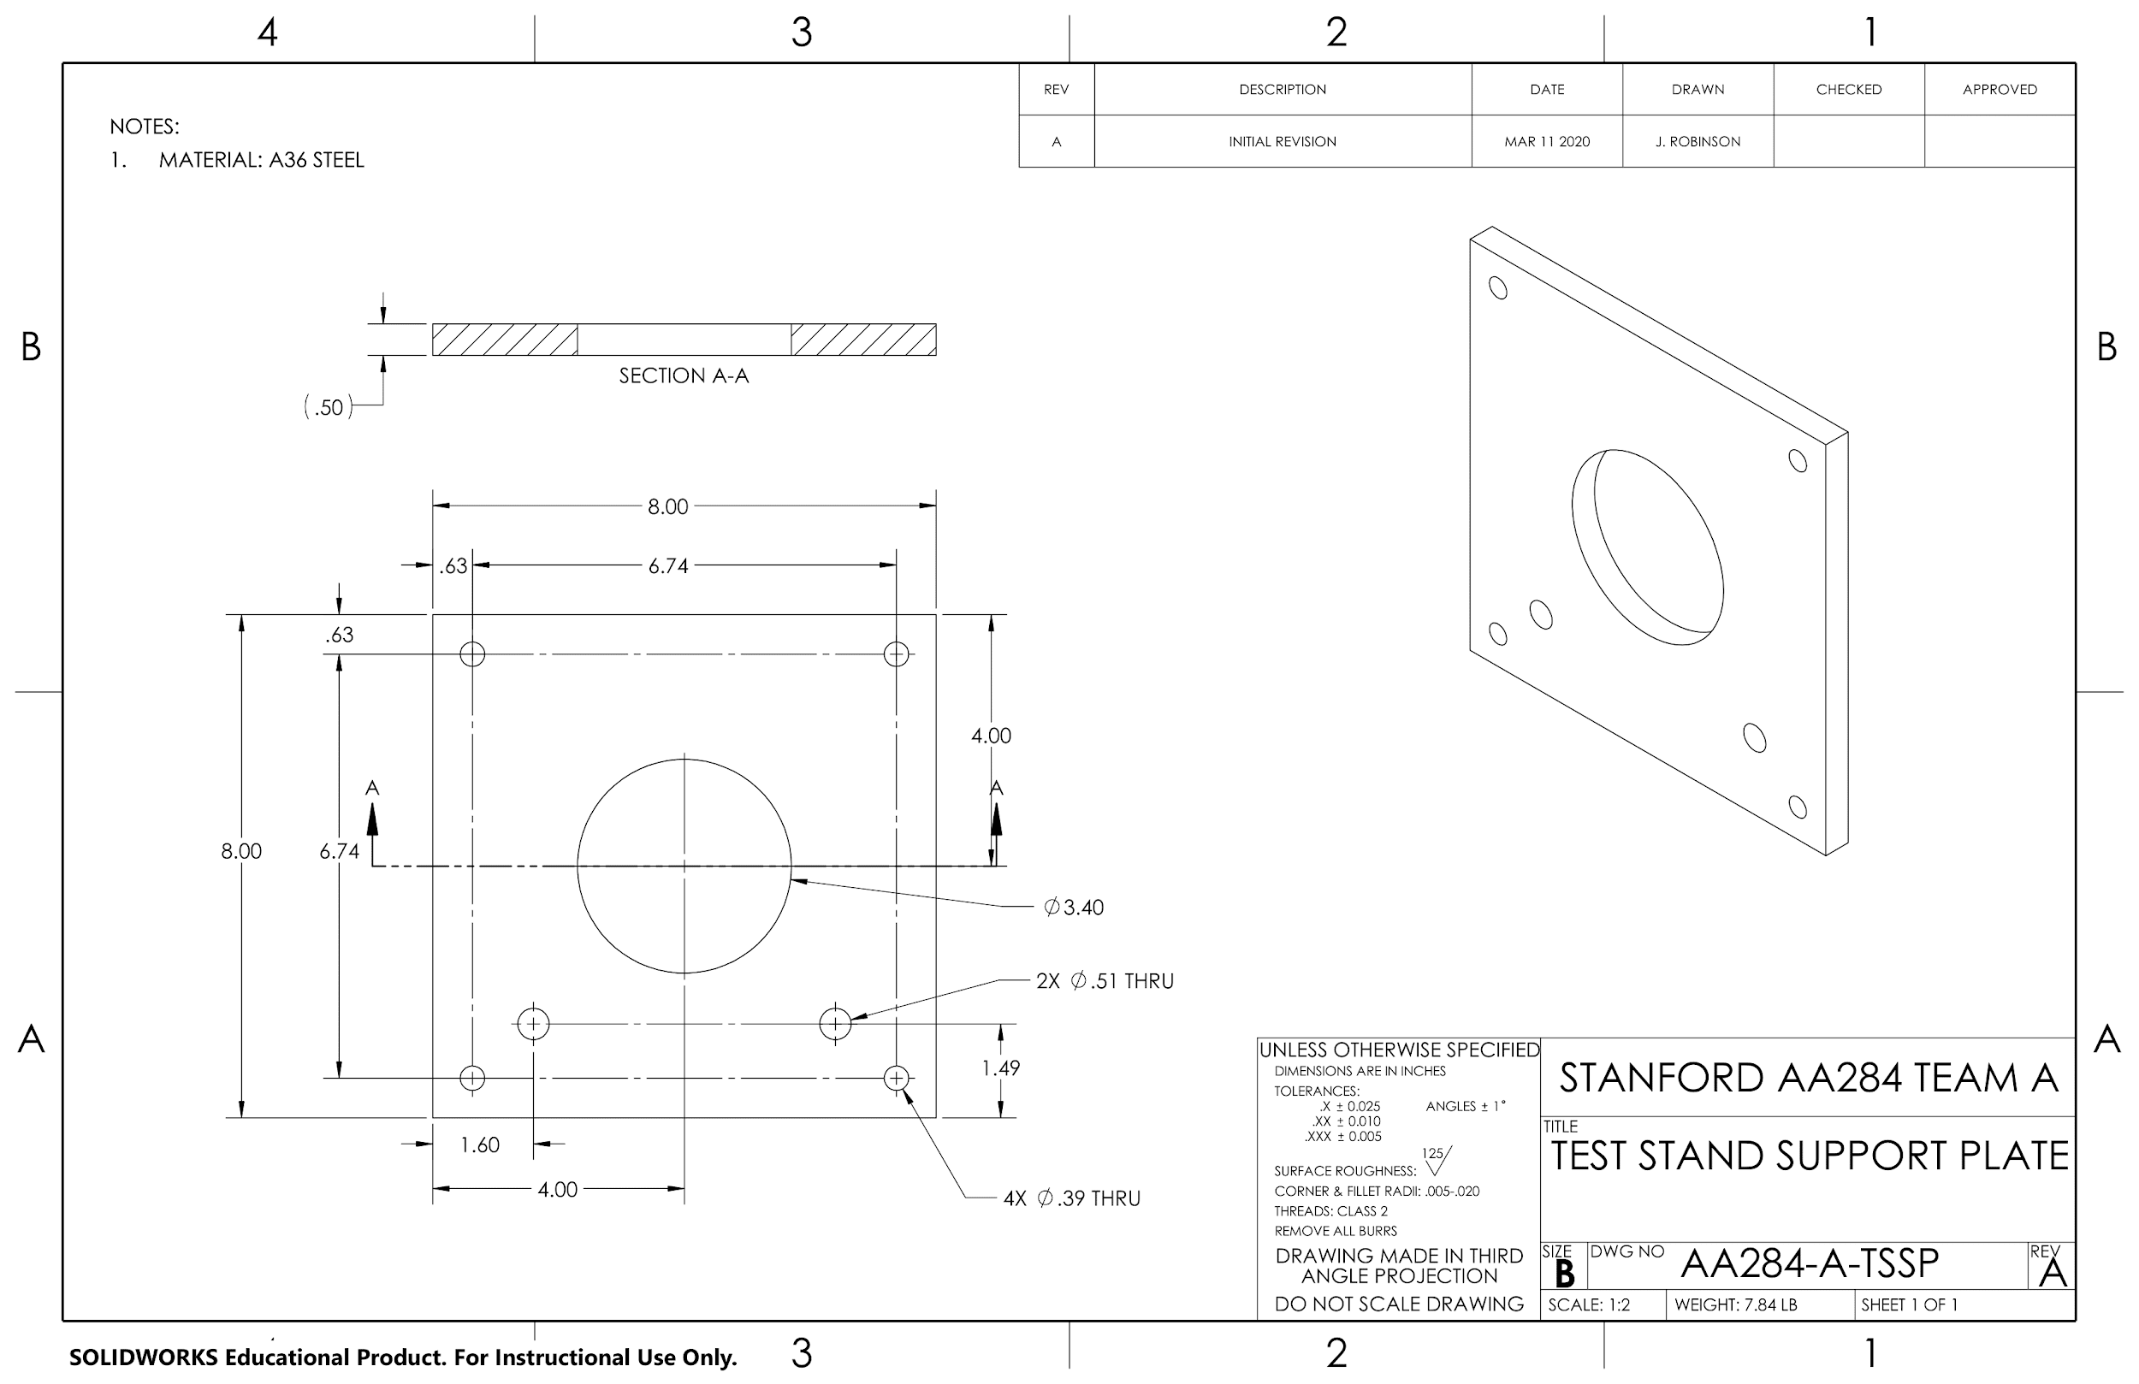

Slide 54
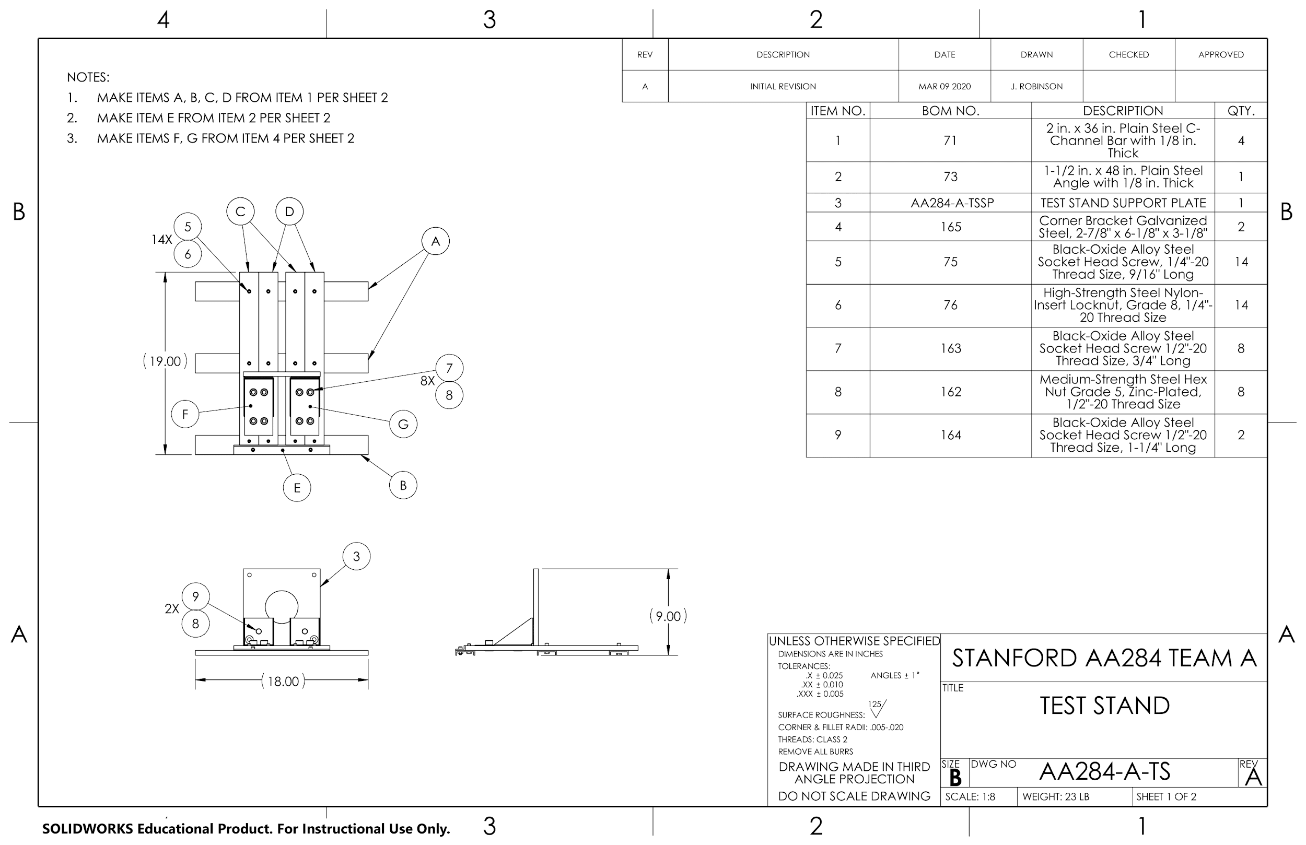

Slide 55
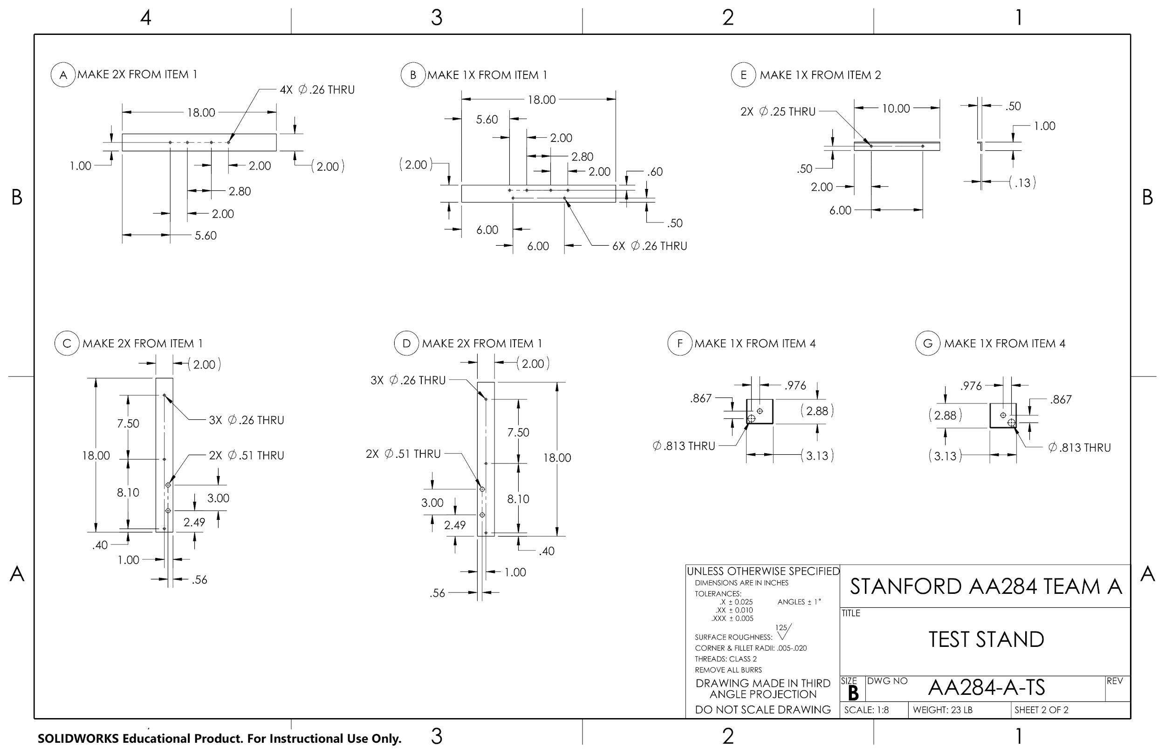

Slide 56


Slide 57


Slide 58


